Slide 1
Enduring Symptoms
An Equity- Focused Psychiatrist’s view
Enduring Symptoms Conference June 24th 2026
Dr Amrit Sachar
Liaison Psychiatrist
West London NHS Trust & Imperial College Healthcare NHS Trust
Co-opted member of RCPsych Faculty of Liaison Psychiatry
Amrit.Sachar@nhs.net

Slide 2
Covering
What brought me to this point
Inequities
  Three key populations with poorer access, experience and outcomes
  Rare diseases
Biopsychosocial model for explaining enduring symptoms in multiple systems
Biopsychosocial model for working with enduring symptoms using compassion
Putting it all together into a toolbox and checklist

Slide 3
Declarations of Interest
Nil financial or academic
Schooled in liaison psychiatry tradition about “Medically unexplained symptoms”
Personal experiences
3 years in RCPsych Presidential Lead role for Equity in Equality
Developing Faculty Strategy on Persistent Physical Symptoms with epistemic justice and Experts by Experience threads –connected with Adrian and Steven

Slide 4
Covering
What brought me to this point
Inequities-food for thought
  Three key populations with poorer access, experience and outcomes
  Rare diseases
Biopsychosocial model for explaining enduring symptoms in multiple systems
Biopsychosocial model for working with enduring symptoms using compassion
Putting it all together into a toolbox and checklist

Slide 5
How inequities shape Enduring Symptoms care
Population | Barriers | Consequences
Women | Symptoms attributed to "stress" or "anxiety“ Lack of research into women’s presentations and conditions and female hormones | Delayed diagnoses (e.g., 20 months for Crohn’s vs. 12 in men). Missed diagnoses –e.g. MI, Endometriosis, menopause
Minoritised ethnicities | Stereotypes about somatisation and pain threshold or drug seeking Language Under-represented in research esp. genomics | Higher ES labelling, fewer referrals for specialists Increased mortality e.g. Black women in childbirth, sickle cell crises
Neurodivergent Patients or people with Learning Disability | Atypical communication Atypical pain expression Increased or decreased sensations | Symptoms misattributed to neurodivergence. Symptoms and signs missed Increased mortality
Intersectionality | Minorities within minorities They are most likely to be excluded in RCTs –CONFOUNDING FACTORS | Where their minority status intersects is most invisible. Research doesn’t get done

Slide 6
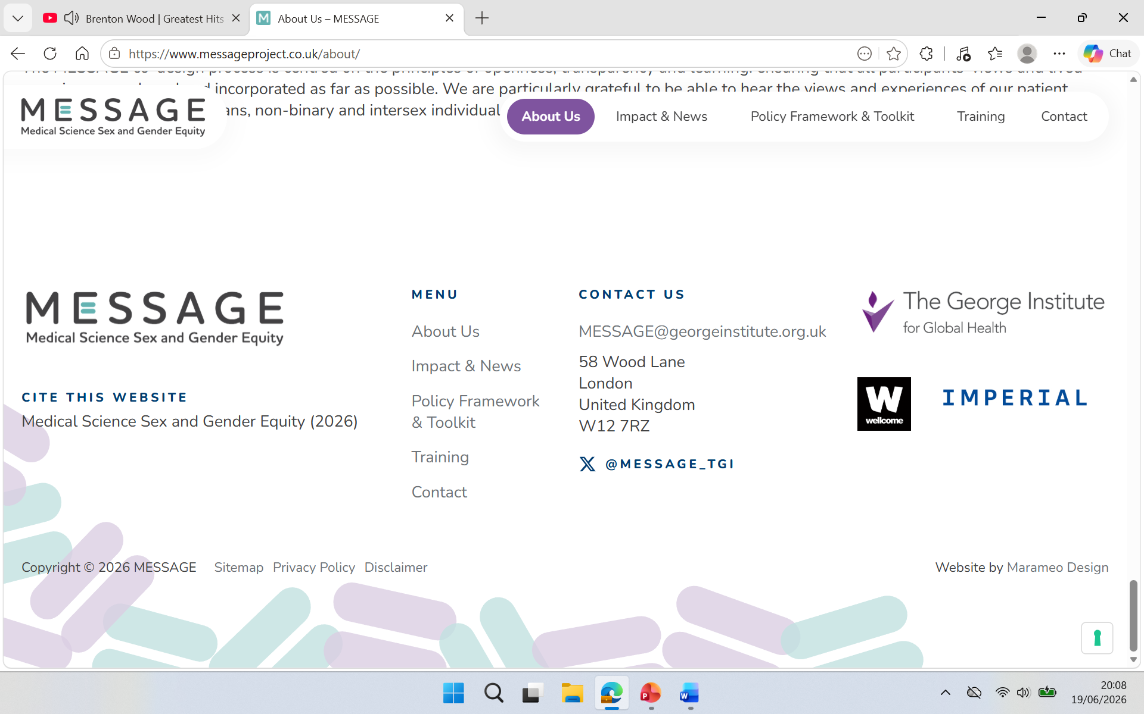
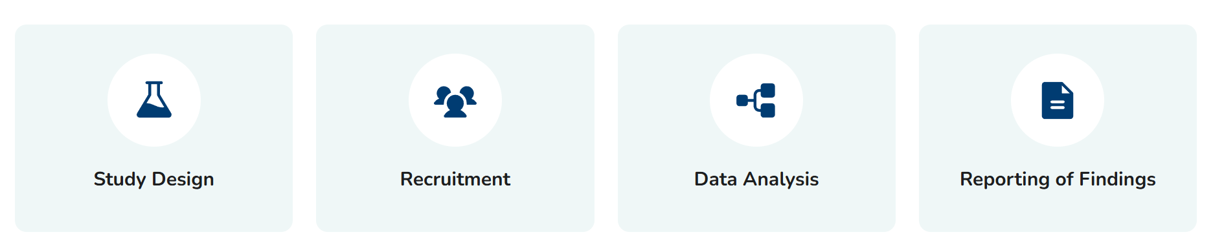
Up to 5.5 times more males than females are used in cell and animal research
In phase I clinical trials, around 20% of participants are women
MESSAGE’s preliminary research in 2021 showed that none of the 17 largest UK medical research funders, nor the UK’s key regulatory bodies, required researchers to account for sex and gender in their studies.
A growing amount of evidence is highlighting how sex and gender can affect health outcomes – it is clear that something must change.

Slide 7
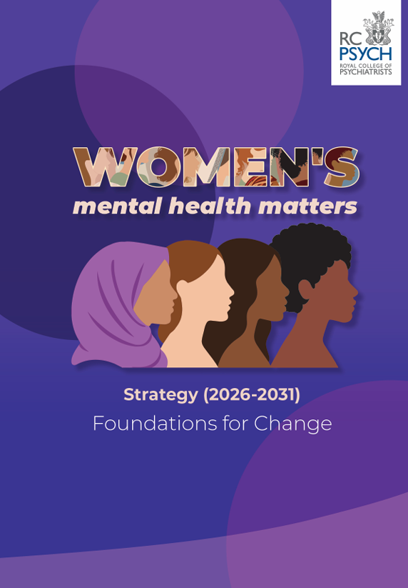
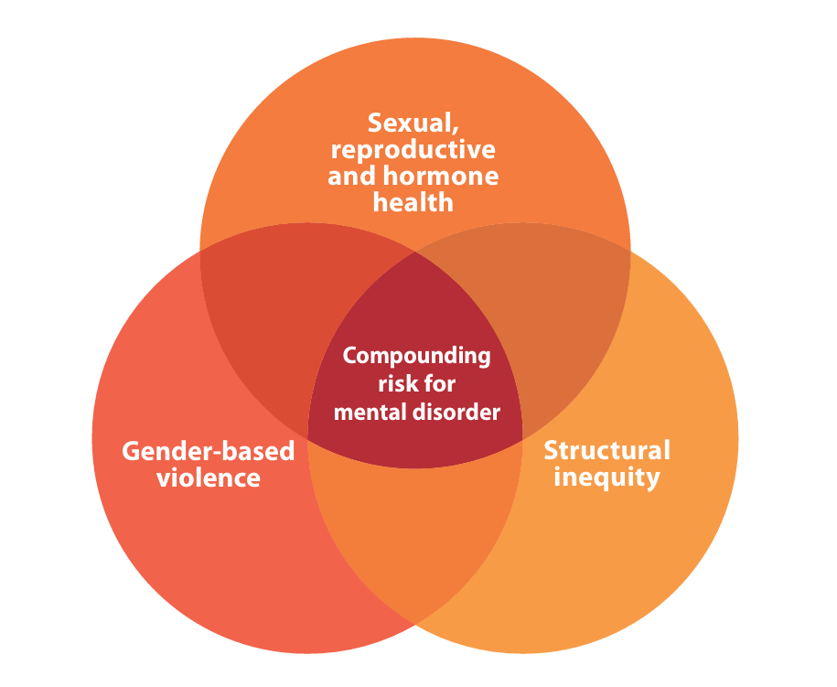
RCPsych Women’s Mental Health Matters
Strategy May 2026 https://www.rcpsych.ac.uk/improving-care/womens-mental-health
3 main
driving factors

Slide 8
RCPsych Women’s Mental Health Matters
Strategy May 2026 https://www.rcpsych.ac.uk/improving-care/womens-mental-health
3 main
driving factors
5 key national priorities
1. National implementation of initiatives that lay the foundation for improvement in women’s mental health.
2. Acknowledge and respond to gender-based violence as a major public health issue for women
3 Create safe, trauma-informed and therapeutic mental health services for women
4. Improve physical health outcomes for women with severe mental illness (SMI) and/or trauma histories
5. Support a workforce equipped to deliver women-centred care.

Slide 9

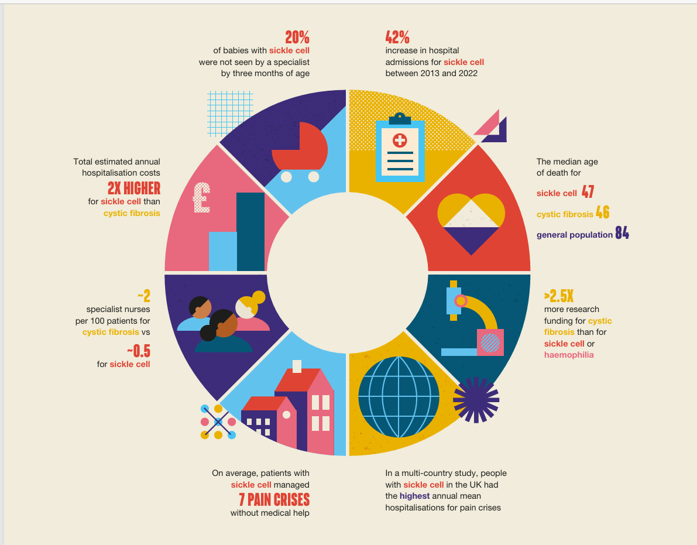
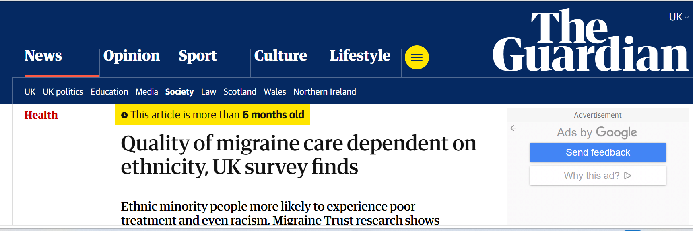
Ethnicity
RHO-Most genomic research historically has been conducted on populations of European ancestry, limiting how well findings generalise to other ethnic groups and potentially worsening health inequalities.
  Stakeholders consistently identified language barriers, mistrust, fear and suspicion of healthcare systems and research as major barriers to participation in genomic services and research.
RHO-Sickle Cell Disease has 4x fewer specialist nurses and 2.5 x less money spent on research compared to Cystic Fibrosis
Migraine Trust-Minoritised ethnic patients up to 3 x less likely (than white patients) to feel believed about their migraine symptoms and that their ethnicity affected their treatment

Slide 10
Learning Disability and Neurodivergence
Sensory sensitivities
Social interactions
Repetitive behaviours and special interests
Autism

Slide 11
Learning Disability and Neurodivergence
Sensory sensitivities
Social interactions
Repetitive behaviours and special interests
Autism
Inattention
Hyperactivity
Impulsivity
ADHD

Slide 12
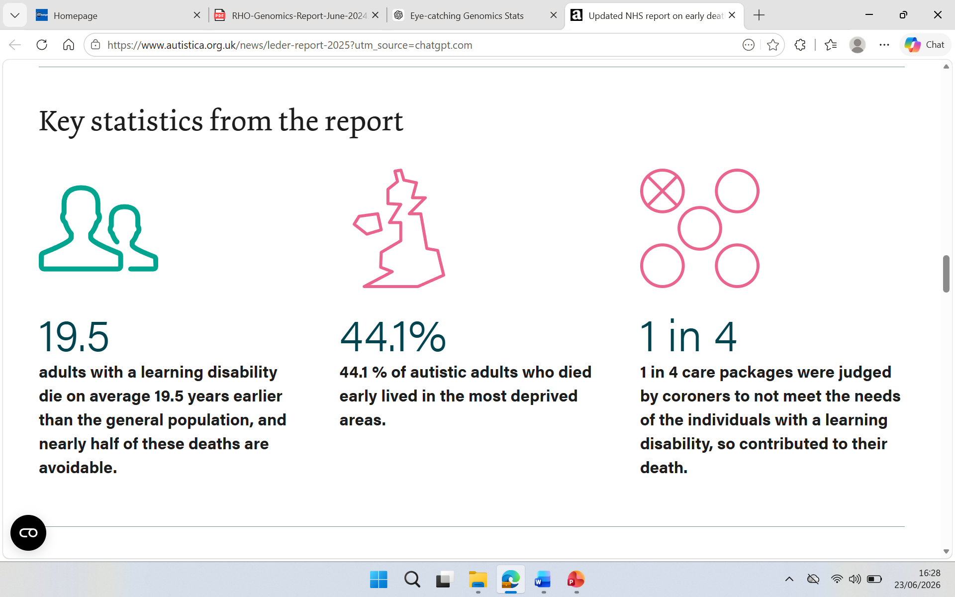

Learning Disability and Neurodivergence
Sensory sensitivities
Social interactions
Repetitive behaviours and special interests
Autism
Inattention
Hyperactivity
Impulsivity
ADHD

Slide 13
Rare Diseases
Rare diseases affect
  3.5 million people in the UK (~1 in 17)
  27 - 36 million people worldwide
Between 6000 and 8000 distinct rare diseases are estimated to exist today
While one rare disease may affect only a few patients, others may affect as many as 245 000
Around 80% of rare diseases are of genetic origin
And yet we know that genetic research leaves out huge groups of people
Diagnostic odysseys
  Average rare disease diagnostic delay: 5–10 years
  Patients often see 5–10 specialists before diagnosis
  Especially with vague, varying and multisystem conditions
  Biomarkers don’t exist until they do

Slide 14
Covering
What brought me to this point
Inequities-food for thought
  Three key populations with poorer access, experience and outcomes
  Rare diseases
Biopsychosocial model for explaining enduring symptoms in multiple systems
Biopsychosocial model for working with enduring symptoms using compassion
Putting it all together into a toolbox and checklist

Slide 15
Current model for multisystem symptoms
peripheral triggers (infection, injury, gut changes, etc.)
→ immune/autonomic changes
→ central nervous system sensitisation
→ persistent symptom loops

Slide 16
Covering
What brought me to this point
Inequities-food for thought
  Three key populations with poorer access, experience and outcomes
  Rare diseases
Biopsychosocial model for explaining enduring symptoms in multiple systems
Biopsychosocial model for working with enduring symptoms using compassion
Putting it all together into a checklist

Slide 17
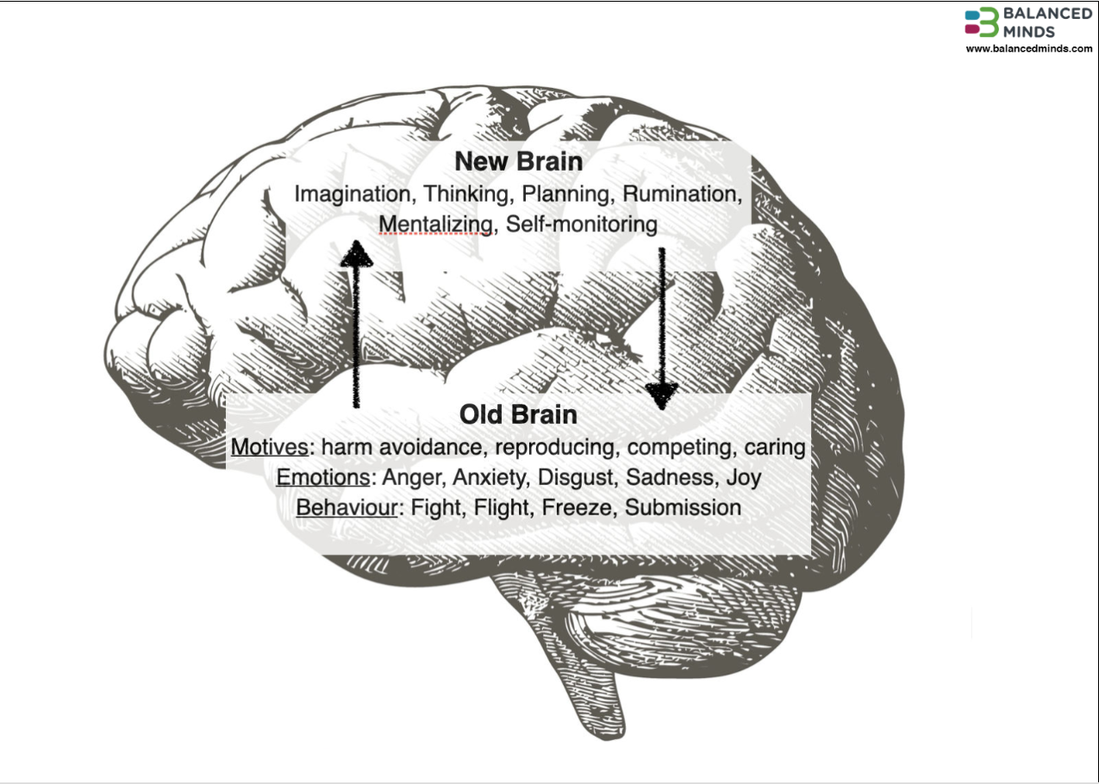

Slide 18
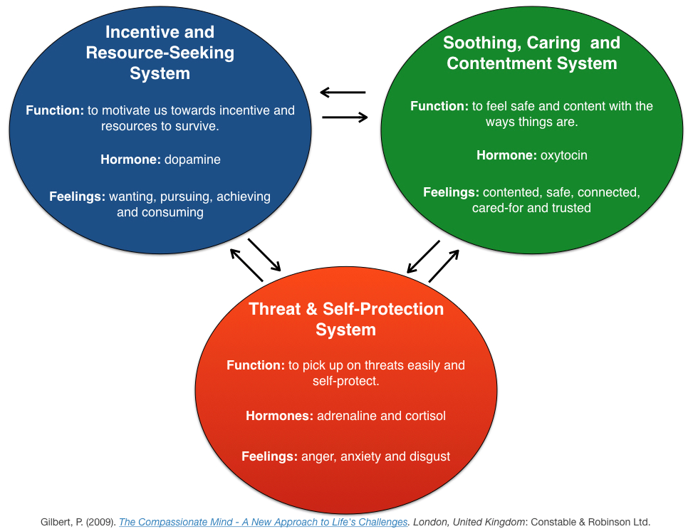
Compassion Focused Therapy
Compassion= being alert to distress and being committed to wanting to relieve that distress (Gilbert)
3 emotional systems

Slide 19
Compassion Focused Therapy a conceptual approach
drive
soothing
threat
3 emotional systems out of balance

Slide 20
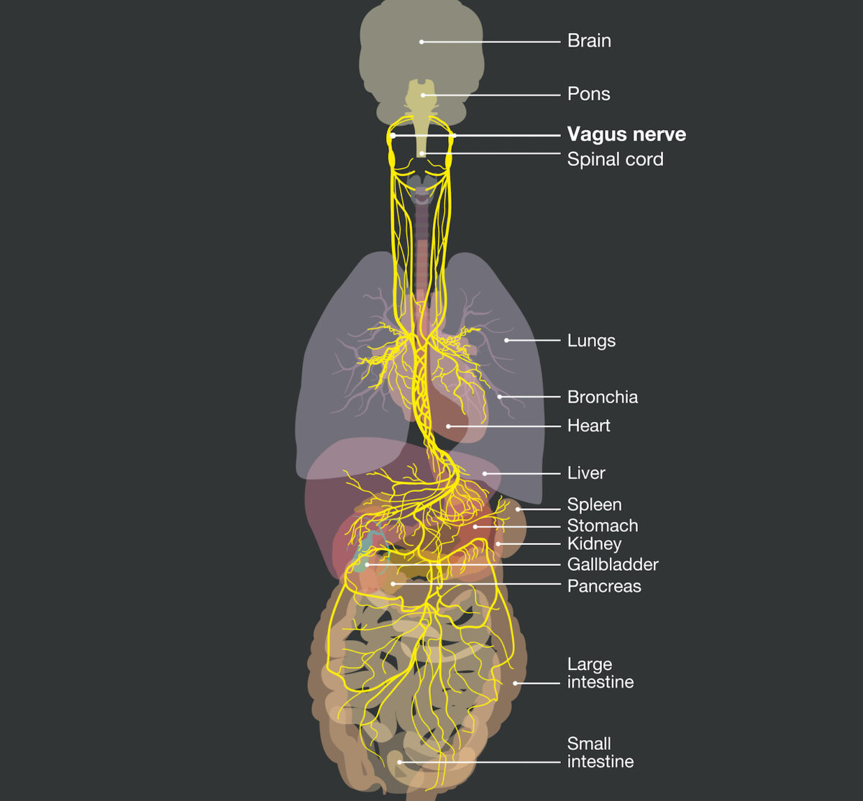
Activating the Soothing
(Rest and Digest) system
Breathing (exhale longer than inhale)
Ear massage
Dive reflex (cold water splashes)
Chanting/singing
Deep pressure stimulation (weighted blankets)
Optimise gut biome

Slide 21
Working with patients with ES using compassion
The CFT conceptual approach
drive
soothing
threat
3 emotional systems more in balance

Slide 22
Clinical checklist
Proactive follow-up arranged- disconnect provision of care from symptoms
Continuity
ensure same 1-2 clinicians to allow for longitudinal therapeutic assessment and management, build trust and allow for changes of time
Provide explanation for symptoms
using autoimmune,
hypersensitive nervous system
Consider whether any psychiatric comorbidity is required to be treated with medication or CBT referral
Believe and validate
Be humble and remain curious
Personalised approach
Offer diagnosis if person wants diagnosis
Develop a shared and evolving formulation
Offer CBT or compassion-focused therapy techniques to co-create solutions
Check baseline beliefs
and views
Equity and rare disease
“mental screen”

Slide 23
IATROGENIC HARM & EQUITY CHECK
Am I over-investigating?
Am I missing biological factors (e.g. hormonal, underrepresentation in research)?
Am I misinterpreting/missing neurodivergent communication or sensory sensitivities?
Am I dismissing a plausible rare condition too early?
Am I underestimating symptoms due to cultural or racial bias?
Have I ensured the patient felt heard and understood?
Am I sure that my Evidence Based Medicine doesn’t have gaps in the way the research was done?

Slide 24
Call to action
Research
Read with equity-lens scrutiny around who was included and who was excluded-
Write to editors if there are gaps that aren’t acknowledged
If you are a researcher, at the very least, consider in limitations, and look at sex- and ethnicity-disaggregated data
Clinical
Validation and believing is part of the clinical intervention
Use a toolbox of approaches and co-create adapt with and for your individual patients
Consider whether the research you are applying is about your patients
Maintain curiosity and openness about formulation, and evolve over time
If you would like to test usability of Primary Care checklist please get in touch

Slide 25
Thank you
Questions? Comments?
Amrit.Sachar@nhs.net

