Slide 1

Problems and solutions of care for people with enduring symptoms
Dr John D Dean
Recently retired physician,
East Lancashire Hospitals NHS Trust
Immediate past Clinical Vice President,
Royal College of Physicians
Notes:
About me. My clinical background, general physician, special interest in diabetes, acute medicine
Why I chose diabetes and acute and general medicine – GIM clinic
Acute presentation 20-50% unexplained by clear pathological cause
Acute and then Long COVID Physician
Long term interest in how services are designed and delivered, particularly for people with LTC, integrated care
CVP Clinical standards, service redesign – acute, outpatients and integrated care, specialism and generalism.

Slide 2
Givens for this talk
Persistent physical symptoms are common
They may have an identified cause and pathophysiology, or may not
Patients with persistent physical symptoms “consume” a large amount of primary and secondary care
Persistent physical symptoms often affect many body systems in the individual patient
Persistent physical symptoms limit patients’ day to day function
Notes:
We don’t know prevalence, as only estimated from presentations to healthcare
Including physical symptoms in patients with clear understood pathological mechanism, less well understood, unexplained
10-50% primary care consultations, 25% outpatient consultations, 20-50% acute presentations – many of these not persistent
Differentiation into General Symptoms (fatligue, brain fog, pruritic, headache), associated with a specific organ system symptomatic heart rate changes, GI symtoms, MS symptoms, neurological symptoms, GU symptoms. Generalised and multiple system symptoms in the same patients)
Significant cause of people not performing daily activities, employment or aspects of other roles.

Slide 3
Construct for talk and discussion
Our current systems of care, and training of health professionals are focussed on making a diagnosis and planning treatment to cure or control a single diagnosed condition for the patient.
People’s expectation when they have symptoms is to be that patient. (relatively passive)
A change of focus to people as individual experts on their own health, supported to function and be well, facilitated by healthcare professionals working together and with other experts.

Slide 4
What is health?
External Factors
Exposure to infections / pollution / Climate / trauma
Family health and behaviours
Education
Housing
Symptomatic, asymptomatic, acute, episodic, prolonged, long term
Social support, networks, relationships
Adverse childhood experiences
Affluence/poverty
Employment
At Risk
Well
Illness
Disease
Internal Factors
Genetics
Immune function
Other diseases
Neuroregulation
Metabolic
Nutrition
Microbiome

Slide 5
How we currently deliver healthcare
Patient presents
Symptoms
Formulate differential diagnosis
History
Working diagnosis and initial management plan
Concerns
Risk factors
Examination
Investigations
Review and modify plan
Further investigation
Medical or other treatment
Wait and watch
Aim is cure or control disease

Slide 6
How care is currently designed
Self care
Primary Care
Secondary specialised care
Social Prescribing
Community
Care

Slide 7
Specialist care
Diabetes and Endocrine
Gastro-enterology
Cardiology
Pain medicine
Respiratory medicine
Rheum-atology
Neurology

Slide 8
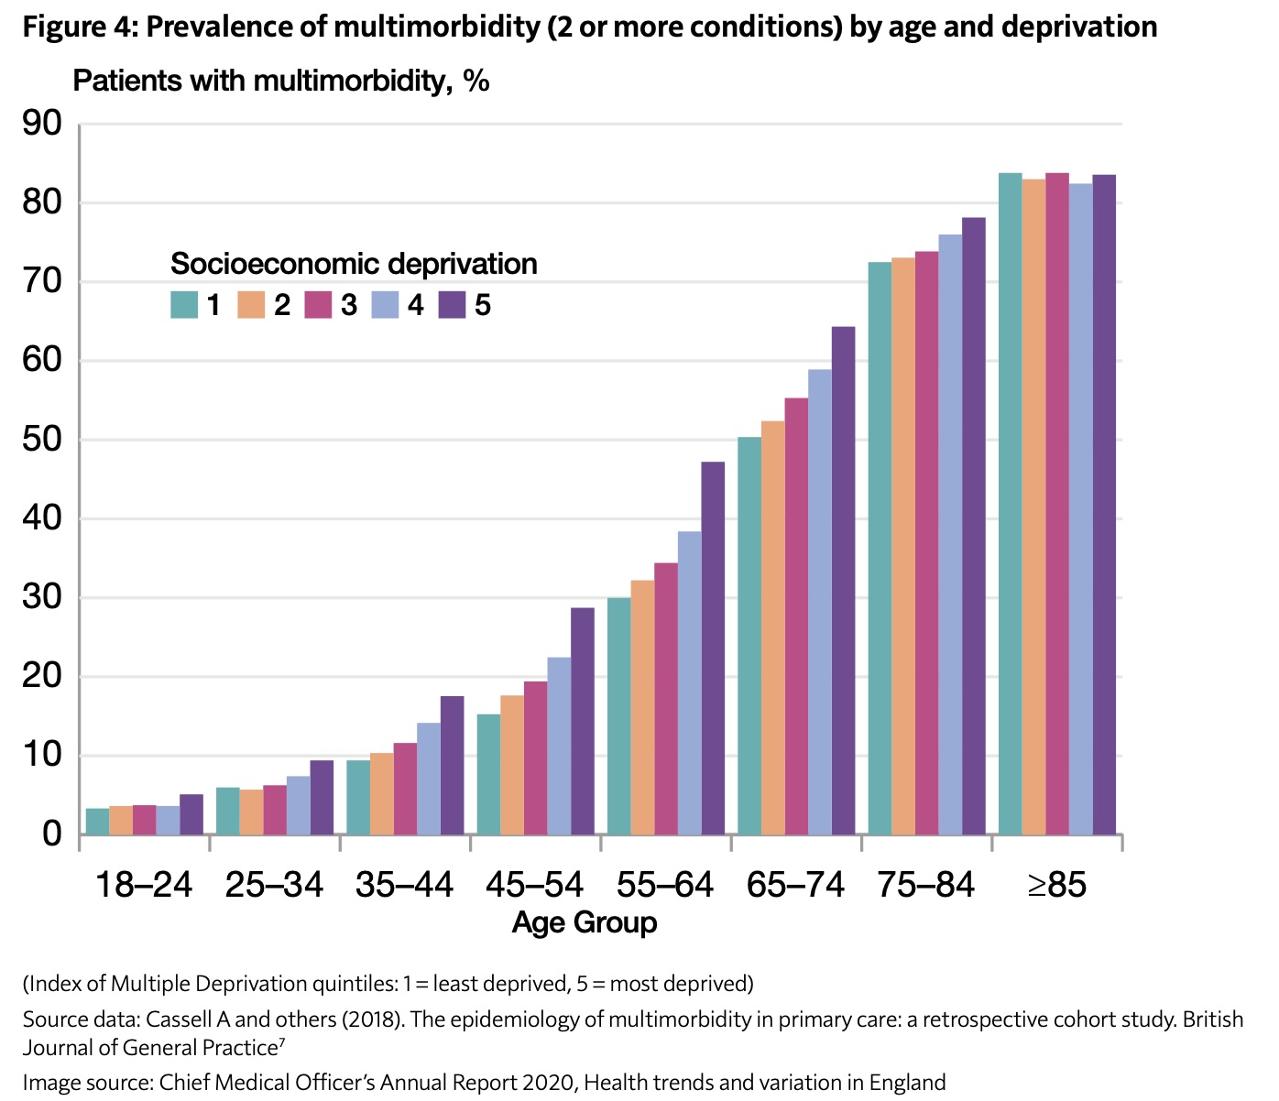
Multiple conditions
Internationally:
< 59 years, 28.0% have multimorbidity
59 to 73 years, 47.6%,
74years and over, 67.0%
In people with multimorbidity, 33.8% have both physical and mental health morbidity.
50% of people with diabetes will have depression at some stage
Fibromyalgia roughly 18.5% of people with type 1 diabetic patients have fibromyalgia, and 15.5% of people with type 2 patients.
Up to 20 % people with Fibromyalgia have diabetes
IBS 30-50 % people with Fibromyalgia

Slide 9
False separation of Physical and Mental Health
Prolonged and
long-term conditions
Short term physical illness
Severe Mental Illness
Anxiety, depression, distress
Notes:
Data
Diabetes
COPD
SMI
Cancer

Slide 10
The need for diagnosis
Challenges:
Diagnostic uncertainty
Symptom based diagnoses
Variation in disease nature, experience and course
Prevalence of symptoms without clear diagnosis
Cognitive biases
New evidence
Need to manage uncertainty
Identification (or exclusion) of serious condition
Urgency of treatment or monitoring
Guide to treatment based on pathology
Explanation of symptoms to patient, and rationale for treatment and/or monitoring
Expectations of illness course for clinician and patient

Slide 11
How we currently deliver healthcare
Patient presents
Symptoms
Formulate differential diagnosis
History
Working diagnosis and initial management plan
Concerns
Risk factors
Examination
Investigations
Review and modify plan
Further investigation
Medical or other treatment
Wait and watch
Passive patient
Aim is cure or control disease

Slide 12
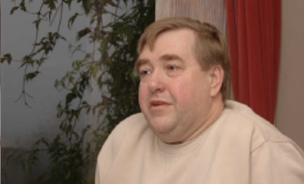
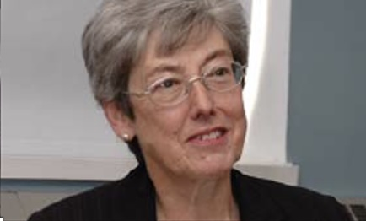
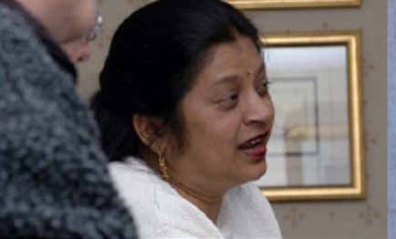
Consider

Slide 13

Fragmented
Not personalised
Variable access
Uncertain delays
Poor communication
Multimodel access
Personalised assessment and care
Team based care
Ongoing support
Maximise technology

Slide 14
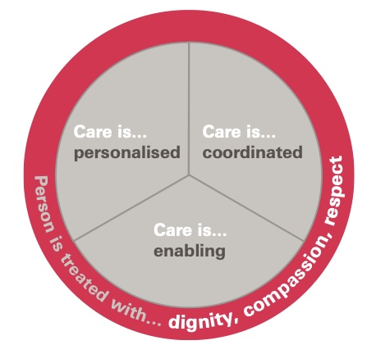
Principles of personalised care

Slide 15
Today’s traditional model of healthcare
Fragmented, dispersed expertise
Focused on diagnosis and treatment to control or cure
Lack of continuity
Single conditions, and multiple specialities
Results in patients seeing multiple clinicians, with different messages
DOES NOT MEET THE NEEDS OF PATIENTS WITH MULTIPLE CONDITIONS, SYMPTOMS THAT SPAN SPECIALITIES, UNCERTAIN DIAGNOSES, DISTURBED LIVES

Slide 16
What can we do differently?
Recognise syndrome of persistent physical symptoms causing distress or disability
  Caused by known diagnosis(es)
  Cause unknown
  Cause undifferentiated
Clarify main components of the syndrome in the individual patient
Develop a generalist personalised approach to clinical practice
Redevelop General Internal Medicine as a speciality
Commission multiprofessional services for people with persistent physical symptoms in each place/neighbourhood, learning from exemplar services that already exists
Educate the public about persistent physical symptom causing distress/disability syndrome
Educate health professionals on – identification, assessment, and management

Slide 17
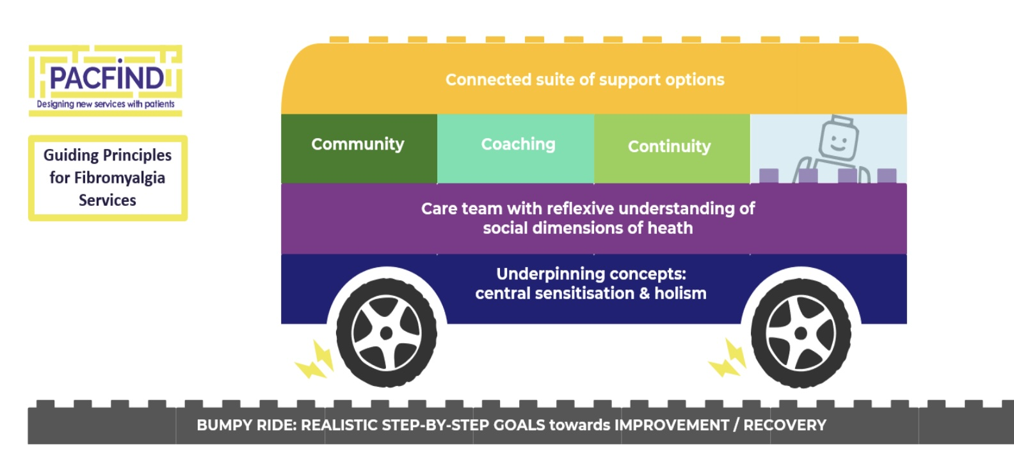
What can we do differently?
Learn from exemplar services for people with Symptom based disorders
Chronic pain services
Fibromyalgia services
CFS/ME services
Long COVID services
IBS

Slide 18
Key Features
Patient centred - whole patient
Validation
Activated patient and family, expert patient
Multiprofessional
Peer support
Education – group based
Coaching approach
Continuity including case management
Lifestyle medicine
Links to local communities and voluntary sector
Links to other specialists, medical and wider
Focus on function, well being and ability with symptom management

Slide 19


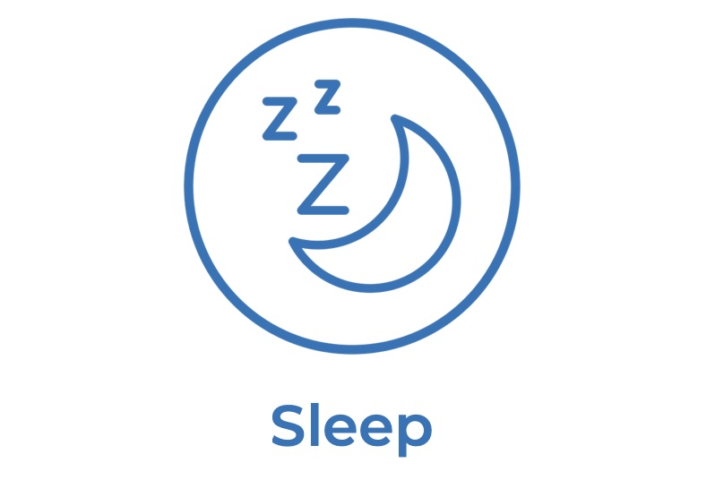



Lifestyle medicine – 6 Pillars

Slide 20
Generalist medicine for the specialist physician - RCP
“Patients do not arrive with diagnostic labels. They come with symptoms – sometimes undifferentiated, often driven by multiple conditions, always embedded in their personal and social context. What they need are physicians who can both dive deep and step back: experts who see the whole person. A well trained and appropriately practicing internal medicine physician should always assess the whole patient, and manage the interaction between their conditions and treatments, including psychosocial aspects. Patients want continuity, coordination and fewer handoffs between clinicians. They want care that minimises disruption to their lives. ”

Slide 21
Future Physicians
Three domains of physicianly practice
Generic skills: communication, diagnosis, managing risk, planning treatment, medicines management, leadership and innovation.
Generalist skills: understanding pathophysiology across conditions, recognising comorbidities, supporting frailty and end-of-life care, integrating psychological factors.
Specialist skills: deep expertise in defined conditions and procedures, alongside competence in managing related comorbidities.
Three types of Physicians
Single specialty with generalist skills applied to their caseload;
Specialty and GIM
GIM physicians, often with a special interest.
All need to function across boundaries, because patients rarely present neatly within them.

Slide 22
The GIM Physician
Internal Medicine Physician
Grounding in major medical specialities
Manages conditions across speciality boundaries
Close links with major medical and surgical specialities
Expert skills in managing and communicating complexity and uncertainty
Expert skills in managing multiple medical conditions and treatments in individual patients
Expert skills in leading and participating in multiprofessional teams

Slide 23
Multiprofessional team
Generalist physicians – diagnosis of conditions and syndromes, recognition of interactions of conditions and treatments, identifying ”red flags”, new and changing conditions, advice on symptom management,
  Primary care – common conditions and comorbidities, ensure preventive care, whole person assessment
  Secondary care – strong links to other specialities, access to investigations, and specialist treatments,
Occupational Therapy – Coaching, goal setting approach to well being, daily living, ability approach to rehabilitation and managing symptoms
Clinical Psychology – supporting team to understand individuals emotional health, distress, need and use of psychological interventions
Dietetics, Nutrition – ensuring appropriate nutrition
Physiotherapy (including respiratory) – helping to support physical function and dysfunction recovery

Slide 24
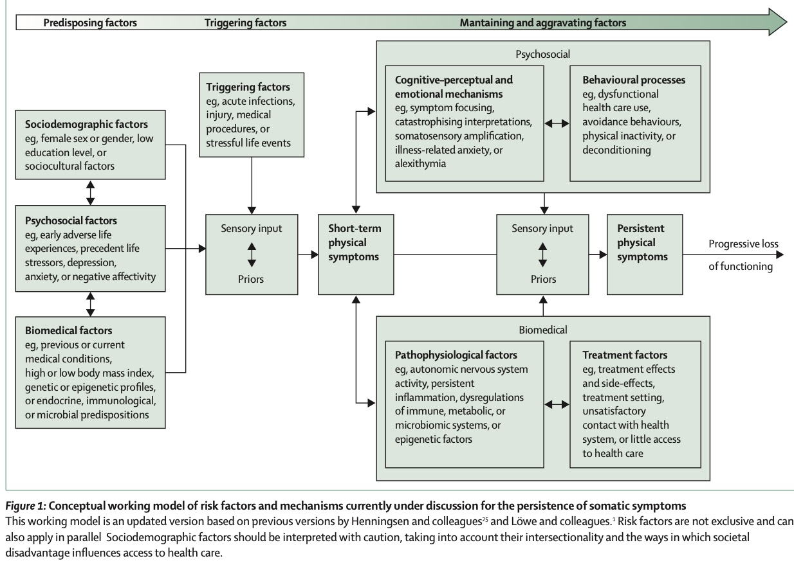

Slide 25
Key components of support for people with persistent physical symptoms causing distress and disability
Validation
Education
Peer support
Coaching and goal setting
Self management support
Targeted assessments and interventions- biopsychosocial
Identification or exclusion of new conditions or exacerbating/alleviating factors
Management of exacerbating/alleviating factors
Reablement

Slide 26

The importance of illness trajectories

Slide 27
How we could deliver care for people with persistent symptoms causing distress and disability
Presentation, or recognition of persistent distressing/disabling symptoms
Confirm or clarify diagnosis, comorbidities, and influencing factors
Assess distress and disability/limitations
Institute treatments to stabilise conditions, and assess effects, including lifestyle medicine
For those with persistent symptoms causing distress and disability refer to specialist MDT
Validation
Education
Self management support
Targeted assessments and interventions- biopsychosocial
Identification of new conditions or exacerbating/alleviating factors
Reablement

Slide 28
What does this mean for:
Services
Look beyond speciality
Biopsychosocial approach
Commission specialist services
Patients
Recognition
Personalised support
Support for self management and reablement
Clinicians
Re-educate
Work beyond traditional speciality boundaries
Recognise and help manage manage distress and disability
Education and training
Generalist personalised medicine
Recognition of persistent physical symptoms syndromes and their management
Research
Epidemiology
Causes and potential treatments
Illness courses and influencing factors
Interventions, including models of care

Slide 29
Recommendations
Recognise persistent physical symptoms as a complex syndrome
Commission multiprofessional services for people with distressing or disabling persistent symptoms, - not for individual diagnoses, based on best practice models
Professional bodies should advocate for people with persistent physical symptoms, and services to support them
Health professional training, greater emphasis on persistent physical symptoms
GIM physicians, develop a special interest as part of MDTs
Research priority for NIHR

