Slide 1


Enduring symptoms:
A neurologist’s perspective
Dr Ania Crawshaw
Neurology consultant
Lewisham and Greenwich NHS Trust
South London and Maudsley NHS Foundation Trust

Slide 2
Enduring symptoms in neurology?
Stroke
Dementia syndromes
Parkinson’s disease
Multiple Sclerosis
Epilepsy
Peripheral neuropathy
Migraine
Functional neurological disorder

Slide 3
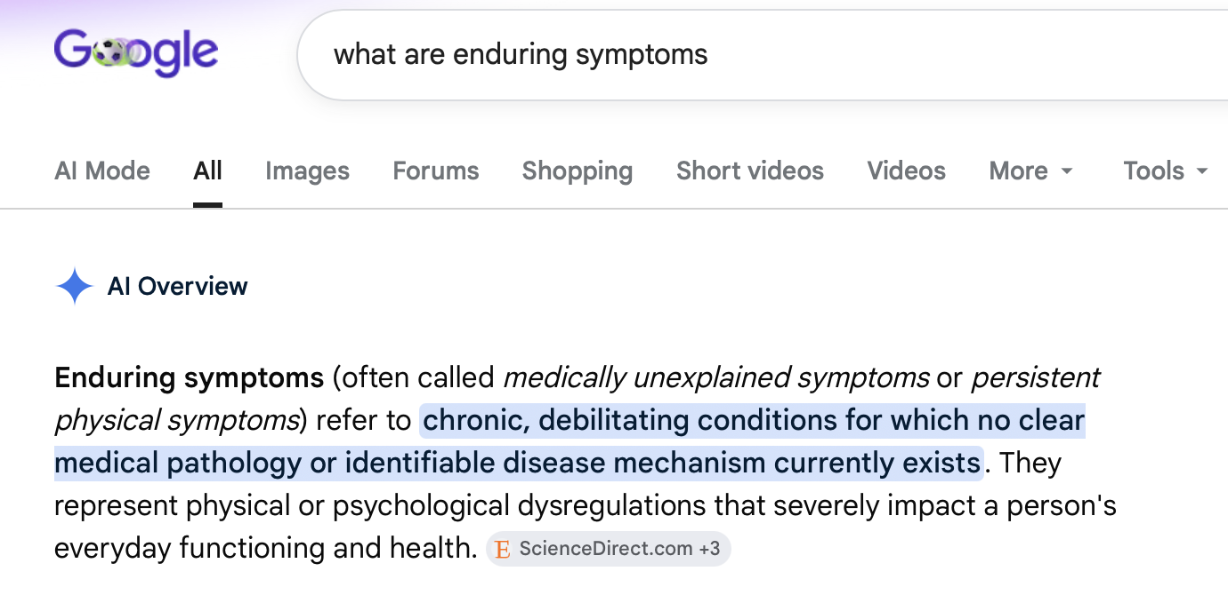

Slide 4
Enduring symptoms in neurology?
Stroke
Dementia syndromes
Parkinson’s disease
Multiple Sclerosis
Epilepsy
Peripheral neuropathy
Migraine
Functional neurological disorder

Slide 5
Overview
What is FND?
Terminology
“Where is the lesion?”
  Traditional and modern approaches to neurological diagnosis
Functional neurological symptoms
  How are they diagnosed?
  How do they occur?
  Why do they occur?
  How can they be treated?

Slide 6
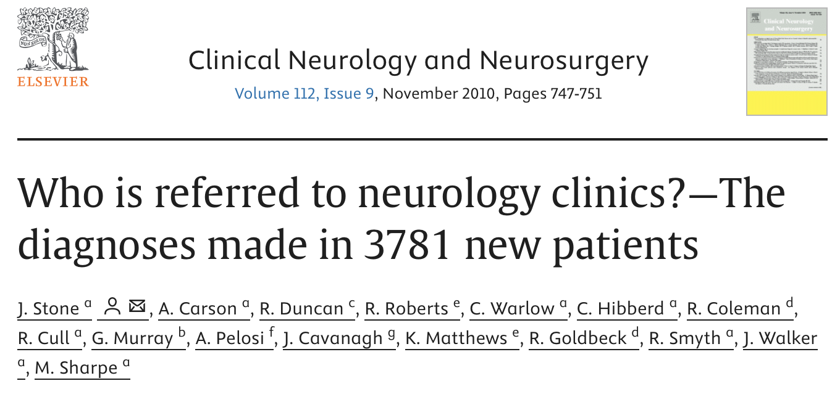
What is Functional Neurological Disorder (FND)?
A common, often disabling condition
6% of neurology clinic consultations
30% of neurology clinic patients have symptoms described as partially or not at all explained by disease
Notes:
Carson, A. and Lehn, A. (2016) Epidemiology. In: Hallett, M., Stone, J. and Carson, A. (Eds.) Handbook of Clinical Neurology. 3rd edn. Elsevier, 47-60.
In a consecutive series of new patients attending outpatient neurology clinic in Scotland over a 15-month period (n = 3781), 5.4% had a primary diagnosis of FND, and 30% had symptoms that were described as only partially or not at all explained by disease [Stone, 2010].
Who is referred to neurology clinics? - the diagnoses made in 3781 new patients.

Slide 7
What is Functional Neurological Disorder (FND)?
A common, often disabling condition
A brain network disorder causing neurological symptoms not directly associated with structural damage to the brain or nervous system. Analogous to a software problem on a computer.
Diagnosed based on positive functional signs (history and examination)
Not a diagnosis of exclusion
6% of neurology clinic consultations
30% of neurology clinic patients have symptoms described as partially or not at all explained by disease
Notes:
Carson, A. and Lehn, A. (2016) Epidemiology. In: Hallett, M., Stone, J. and Carson, A. (Eds.) Handbook of Clinical Neurology. 3rd edn. Elsevier, 47-60.
In a consecutive series of new patients attending outpatient neurology clinic in Scotland over a 15-month period (n = 3781), 5.4% had a primary diagnosis of FND, and 30% had symptoms that were described as only partially or not at all explained by disease [Stone, 2010].
Who is referred to neurology clinics? - the diagnoses made in 3781 new patients.

Slide 8
Manifestations of FND
Tremor
Weakness
Muscle spasm
Movement
Brain fog
Fatigue
Tics
Gait problems
Cognition
Swallowing problems
Jerks and twitches
Speech problems
Dizziness
Pain
Tingling
Sensation
Dissociation
Consciousness
Numbness
Vibration
Seizures
Blindness
Blackouts
Notes:
- Lots of symptoms
List
Take each symptoms in turn
Consider whether unifying diagnosis, or whether dual diagnosois – eg migraine and FND; BPPV and FND

Slide 9
Manifestations of FND
Tremor
Weakness
Muscle spasm
Movement
Brain fog
Fatigue
Tics
Gait problems
Cognition
Incontinence
Swallowing problems
Jerks and twitches
Speech problems
IBS
Chest pain
Palpitations
Dizziness
Pain
Tingling
Sensation
Dissociation
Consciousness
Numbness
Vibration
Seizures
Blindness
Blackouts
Notes:
- Lots of symptoms
List
Take each symptoms in turn
Consider whether unifying diagnosis, or whether dual diagnosois – eg migraine and FND; BPPV and FND.
10% of patients with functional neurological symptoms have a second neurological diagnosis

Slide 10
Overview
What is FND?
Terminology
“Where is the lesion?”
  Traditional and modern approaches to neurological diagnosis
Functional neurological symptoms
  How are they diagnosed?
  How do they occur?
  Why do they occur?
  How can they be treated?

Slide 11
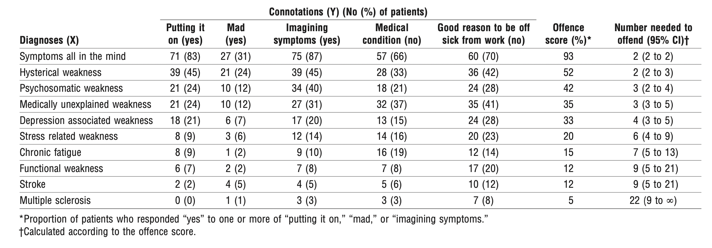
What should we say to patients with symptoms unexplained by disease? The “number needed to offend”. Stone et al, 2002. https://doi.org/10.1136/bmj.325.7378.1449
If you had leg weakness, your tests were normal, and a doctor said you had ‘x’ would he be suggesting that you were Y (or had Y)?

Slide 12
Terminology / disambiguation
Under the functional umbrella:
Outdated / unhelpful terms:
Not to be confused with:
Functional neurological disorder
Hysteria
Malingering
Functional neurological symptoms
Psychogenic/psychosomatic symptoms
Factitious disorder
Medically Unexplained Physical Symptoms
Medically Unexplained Symptoms (MUPS/MUS)
Functional overlay
Functional/ dissociative seizures
Pseudoseizures / Non-epileptic attacks
Conversion disorder

Slide 13
Overview
What is FND?
Terminology
“Where is the lesion?”
Traditional and modern approaches to neurological diagnosis
Functional neurological symptoms
  How are they diagnosed?
  How do they occur?
  Why do they occur?
  How can they be treated?

Slide 14
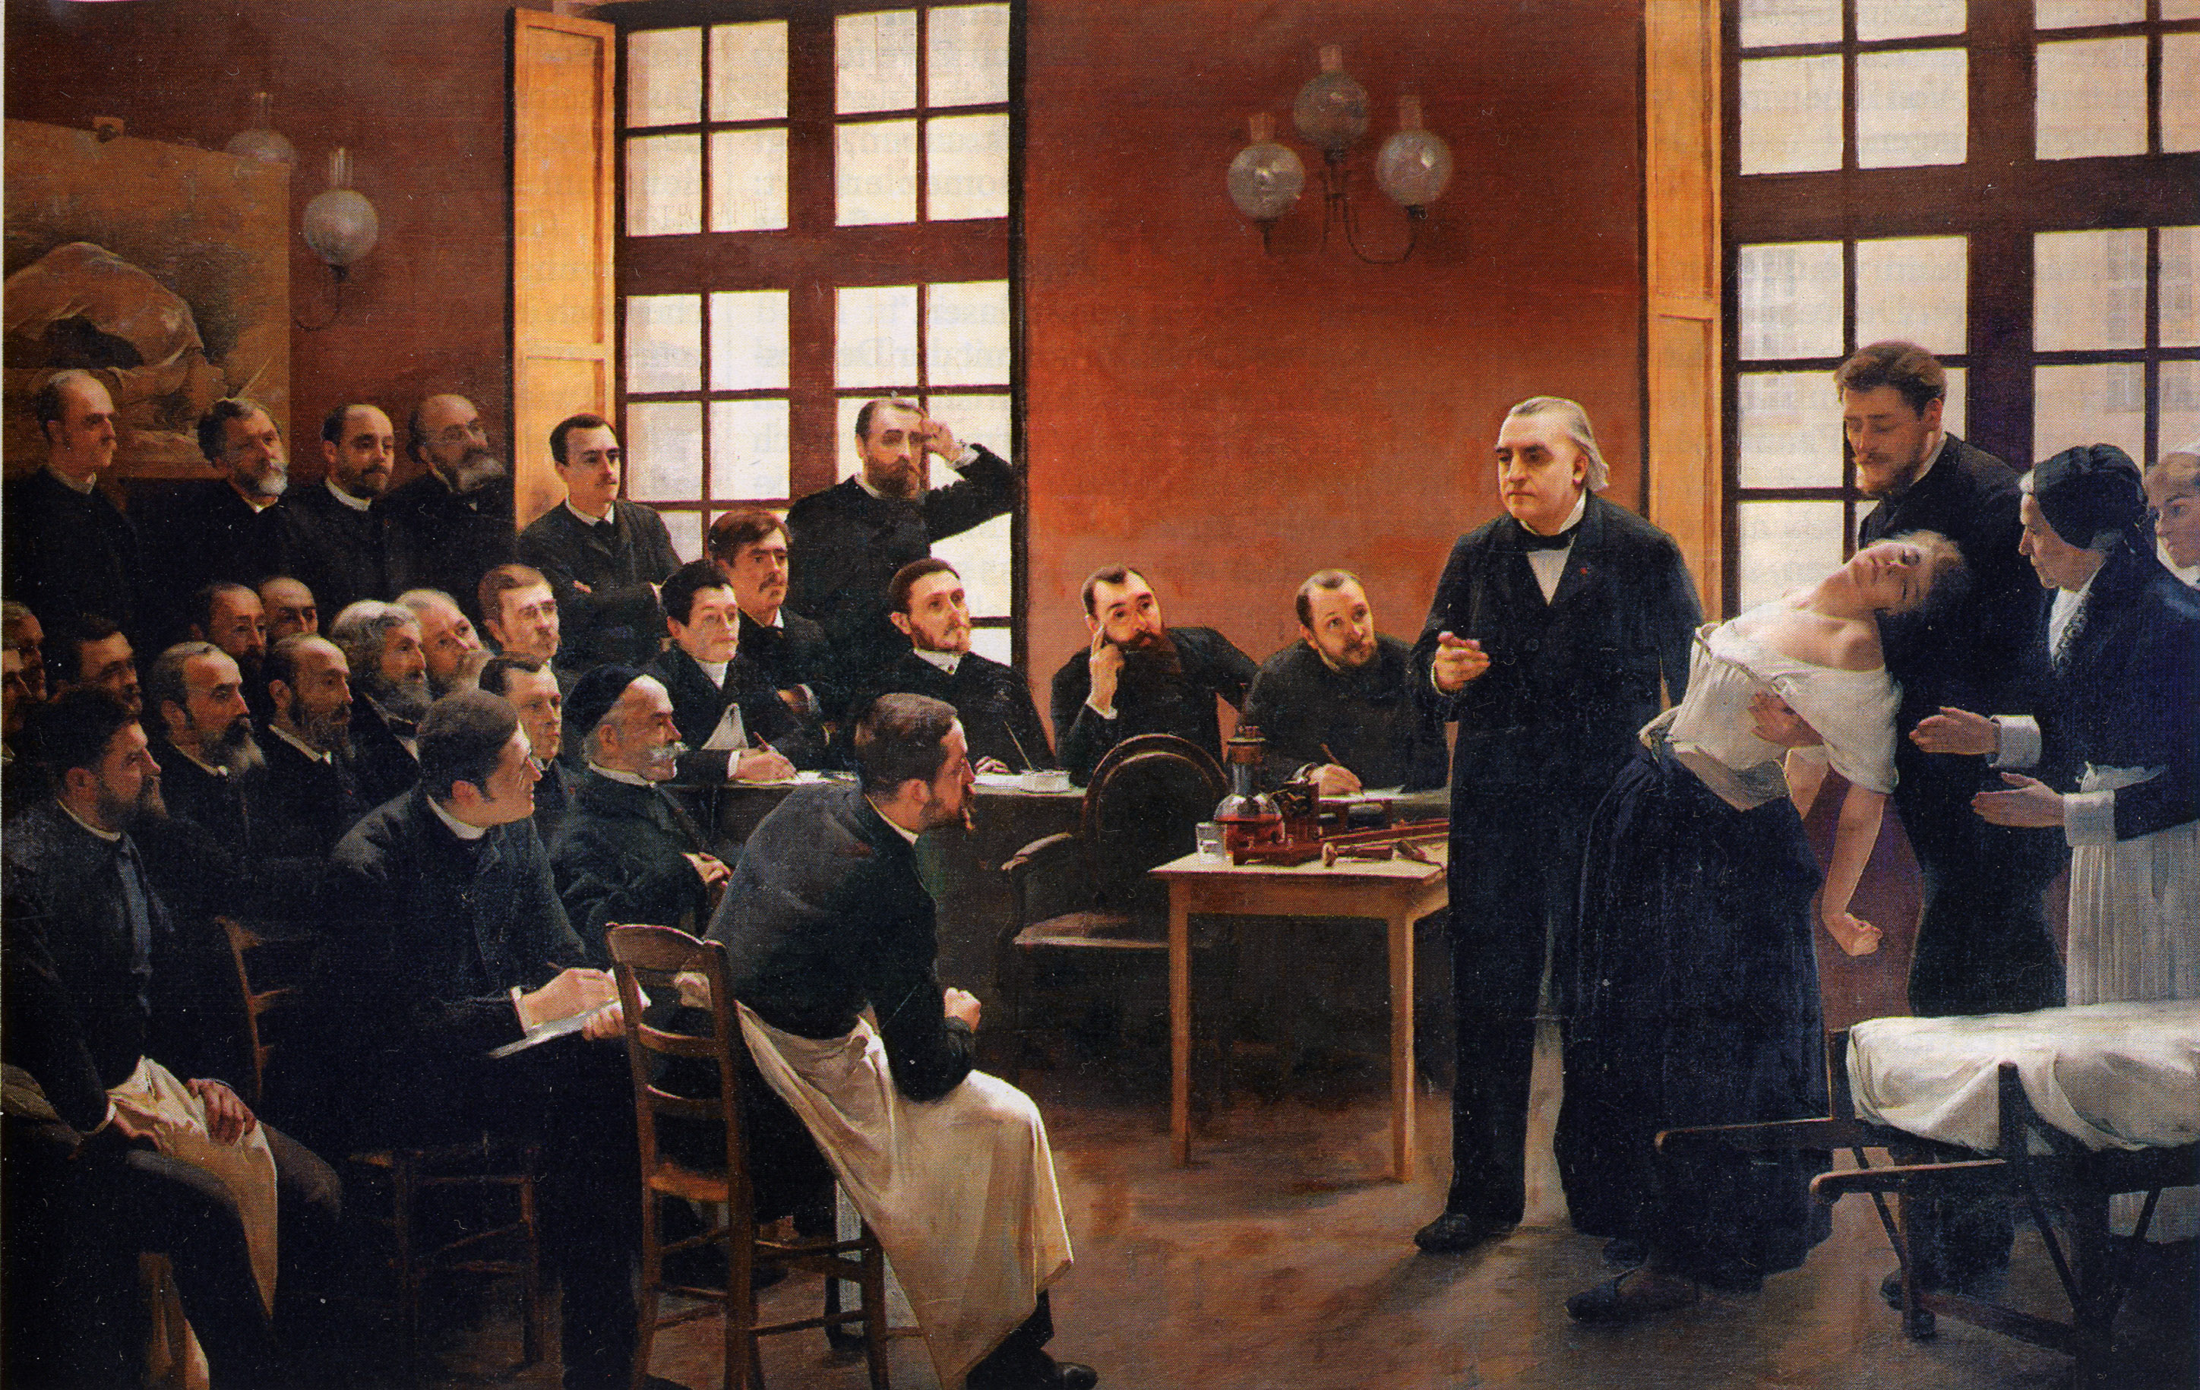
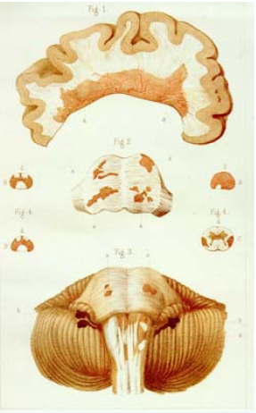
The anatomo-clinical method

Slide 15
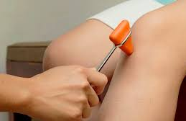
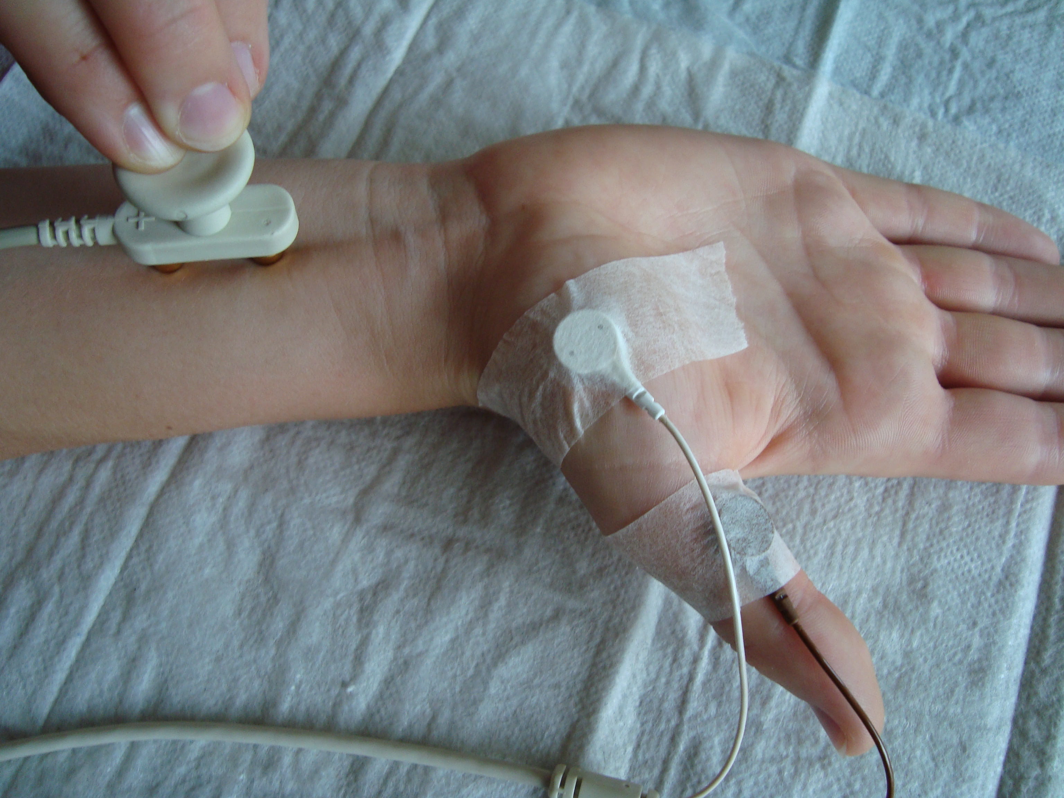
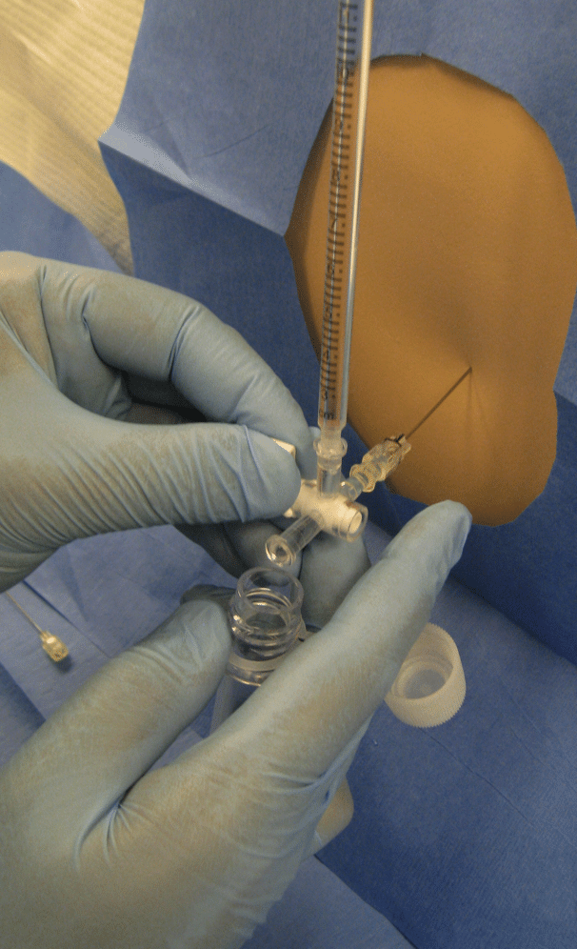
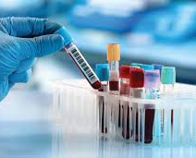
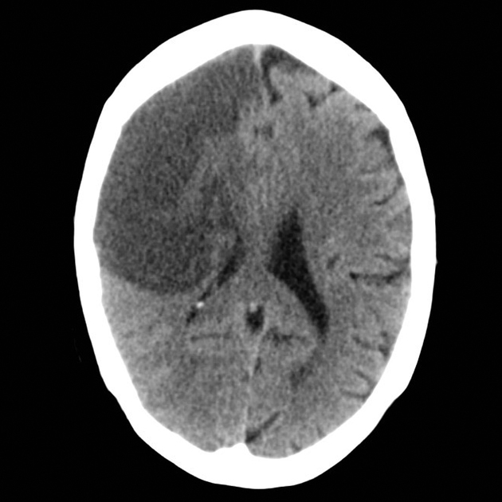
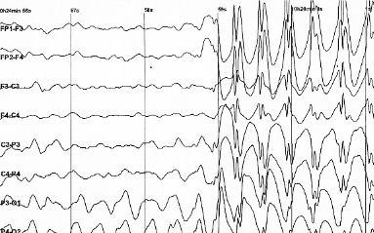
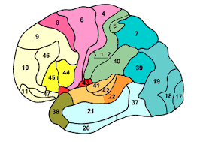
“Where is the lesion?”

Slide 16
La lésion dynamique
Jean-Martin Charcot (1889) on ‘hysteria’ :
‘There is, without doubt, a lesion of the nervous centres but where is it situated and what is its nature? … But certainly, it is not of the nature of a circumscribed organic lesion of a destructive nature … it is one of those lesions which escape our present means of anatomical investigation, and which for want of a better term, we can designate dynamic or functional lesion’

Slide 17
19th century
20th century
21st century
Neurology
Psychiatry
“Nervous disorders”
Brain disorders?

Slide 18
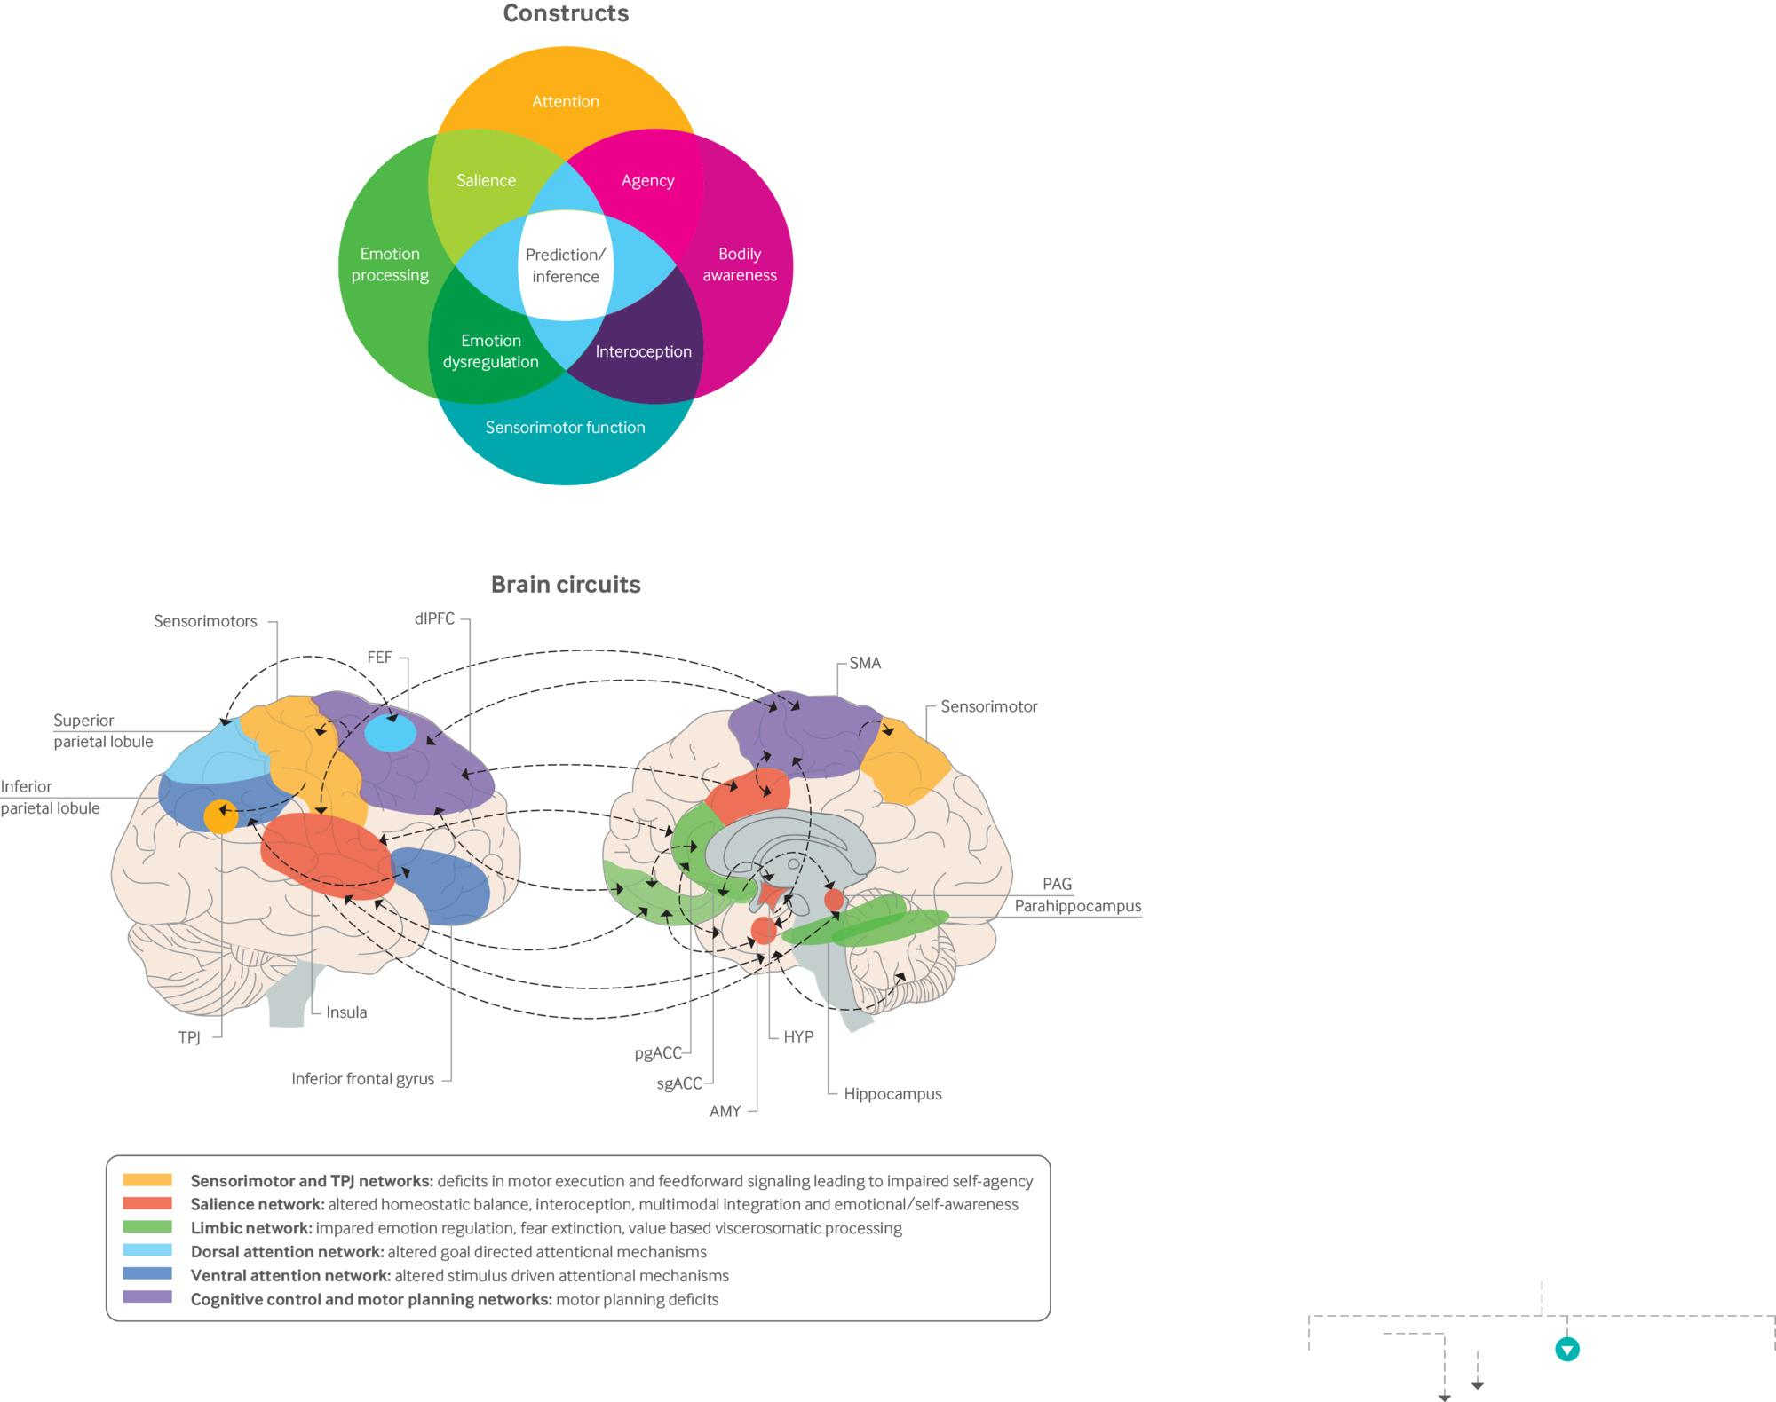

Emerging pathophysiology of functional neurological disorder
Selma Aybek, and David L Perez BMJ 2022;376:bmj.o64
©2022 by British Medical Journal Publishing Group
Notes:
Emerging pathophysiology of functional neurological disorder In the top panel, core constructs implicated in FND are highlighted, including disturbances in attention, self-agency, prediction/inference, and emotion/threat processing. In the bottom panel, the brain circuits implicated in the pathophysiology of FND (and their interactions) are displayed. As depicted, FND is a multi-network disorder involving abnormalities within and across brain circuits implicated in sense of agency, emotion/threat processing, attention, homeostatic balance, interoception, multimodal integration, and cognitive/motor control, among other functions. Circuits are described by their related dysfunction in the pathophysiology of FND. Several areas cut across multiple networks; for example, the dorsal anterior insula is most strongly interconnected with the dorsal anterior cingulate cortex, while the posterior insula receives afferent projections from the lamina I spinothalamocortical pathway and somatosensory cortices. Similarly, the amygdala is part of both the salience and limbic networks. Prefrontal brain regions are interconnected with striatal-thalamic areas (not shown), and these pathways should also be factored into the neural circuitry of FND. AMY=amygdala; dlPFC=dorsolateral prefrontal cortex; FEF=frontal eye fields; HYP=hypothalamus;; PAG=periaqueductal gray; pgACC=perigenual anterior cingulate cortex; sgACC=subgenual anterior cingulate cortex; SMA=supplementary motor area; TPJ=temporoparietal junction. Figures reproduced with permission from Drane et al 2020 CNS Spectrums

Slide 19
Overview
What is FND?
Terminology
“Where is the lesion?”
  Traditional and modern approaches to neurological diagnosis
Functional neurological symptoms
  How are they diagnosed?
  How do they occur?
  Why do they occur?
  How can they be treated?

Slide 20
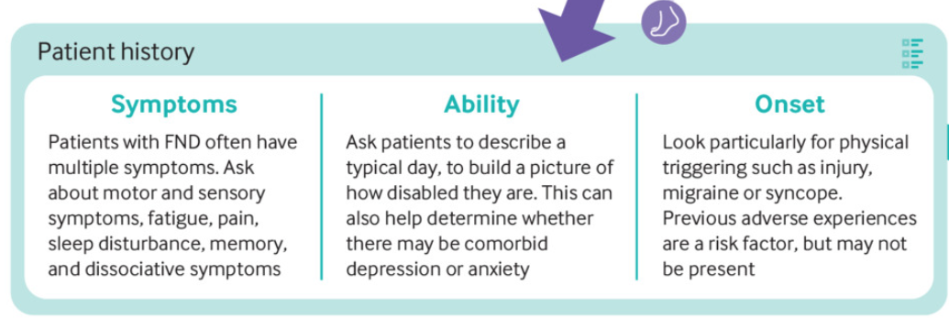
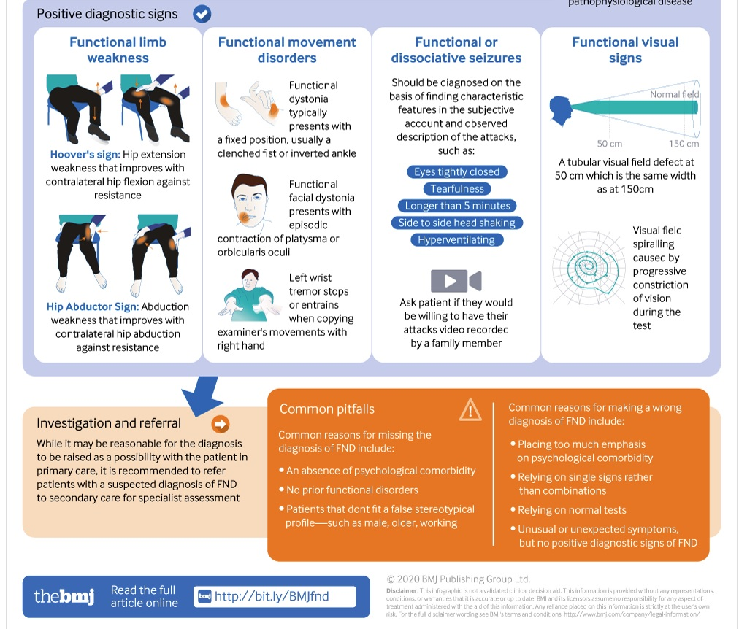
Examination
FND diagnosis should be based on positive clinical features which may demonstrate:
Inconsistency between impaired voluntary movement and intact automatic movement
Different examination patterns compared to those commonly seen in patients with structural lesions (damage) to the nervous system

Slide 22
Overview
What is FND?
Terminology
“Where is the lesion?”
  Traditional and modern approaches to neurological diagnosis
Functional neurological symptoms
  How are they diagnosed?
  How do they occur?
  Why do they occur?
  How can they be treated?

Slide 23

Underlying mechanisms of FND
Voluntary vs automatic function
Attention
Expectation - priors vs posteriors

Slide 24

Voluntary vs automatic function
When we are functioning normally, if we want our body to do something, it will do it automatically.
Movement is fundamentally an automatic process which can be directed by the spotlight of attention, but is not as “voluntary” as we think.
Systems exist that allow “us” to interface with the automatic machinery of our bodies and to experience ownership and control over our bodies.
Patients with FND experience loss of access to the automatic function of the body

Slide 25
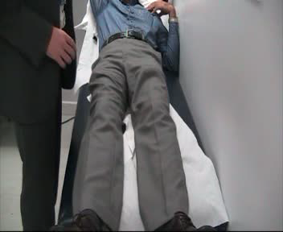

Slide 26
Underlying mechanisms of FND
Voluntary vs automatic function
Attention
Expectation - priors vs posteriors

Slide 27
Attention modulates function and experience in everyone
Tip of the tongue phenomenon
Playing music or performing another motor skill deliberately slower than normal
Distraction techniques when taking blood

Slide 28
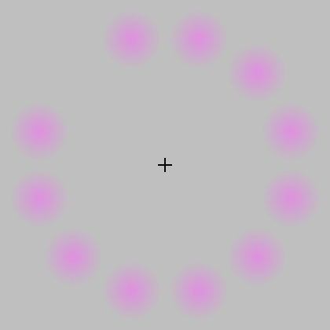
Notes:
In addition to the impact of expectation on our experience of our bodies and the world, attention is another potent modulating factor.
Observe initially the pink dots forming this circle, before giving your full focus to the cross in the middle. Coming closer to the screen can help make the illusion more powerful.
With intense focus on the cross, a green dot starts to appear, and the pink dots start to fade and disappear almost entirely. However as soon as focus is switched back to the circle, the pink dots reappear and the green dot vanishes again.
In this optical illusion, our internal visual images changes dramatically depending on where our attention is focused.

Slide 29

FND is a disorder of attention
The more attention is placed on the activity that is difficult, the harder it becomes.
The harder the person tries the worse the problems gets
Function improves with distraction (diverted attention)

Slide 30
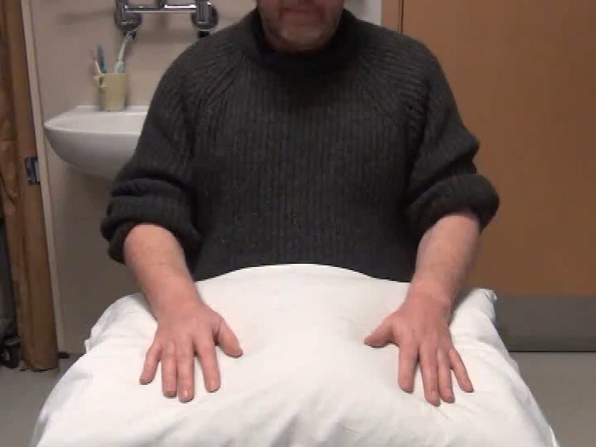
Distractibility
Entrainment
Pause with ballistic movement
Signs of functional tremor:

Slide 31
Underlying mechanisms of FND
Voluntary vs automatic function
Attention
Expectation – priors vs posteriors

Slide 32
OUR CONSCIOUS REALITY
Hearing
Exteroception
Vision
Smell
Taste
Interoception
Touch
Notes:
Each of us experiences a different version of reality, dependent on the signals coming into our brain, and on our expectations based on previous experience. Our conscious reality is in fact just one representation of the world, rather than an accurate replication.
The incoming signals come from the *outside world and from *inside our bodies, otherwise known as extero- and interoception.
*The 5 exteroceptive senses include touch, smell, taste, vision and hearing.

Slide 33
OUR CONSCIOUS REALITY
Hearing
MEDIATED BY THE AUTONOMIC NERVOUS SYSTEM
Perception of organ system function
Heartbeat
Blood flow
Satiety, thirst, hunger
Internal pressure, stretch or constriction
Pain
Perception of emotion
Anxiety, anger, love, joy, fear etc
Interoception
Notes:
Interoception is mediated by the autonomic nervous system, featuring neurotransmitters like adrenaline.
*It allows perception of organ function, for example our hearbeat and blood flow, feelings of fullness, hunger and thirst, as well as feelings of internal pressure and pain.
*Another important aspect of interoception is the perception of emotions, be these anxiety, anger, love, joy or fear.
*There is significant overlap between our bodily sensations and our emotions - for example anxiety, anger and love may all be associated with an increased heartrate, or feeling in the pit of the stomach.

Slide 34
OUR CONSCIOUS REALITY
Hearing
Exteroception
Vision
Smell
Organs
Taste
Interoception
Touch
Emotion
Notes:
Each of us experiences a different version of reality, dependent on the signals coming into our brain, and on our expectations based on previous experience. Our conscious reality is in fact just one represenation of the world, rather than an accurate replication.
The incoming signals come from the *outside world and from *inside our bodies, otherwise known as extero- and interoception.
*The 5 exteroceptive senses include touch, smell, taste, vision and hearing.

Slide 35
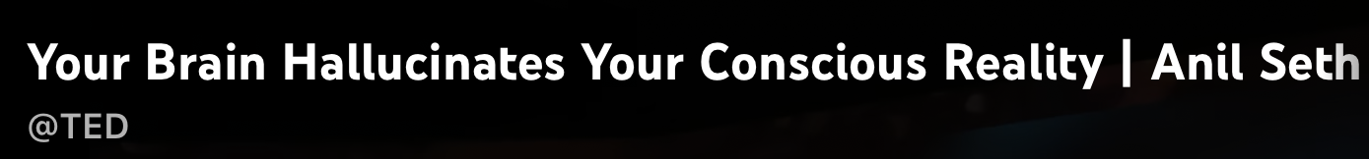
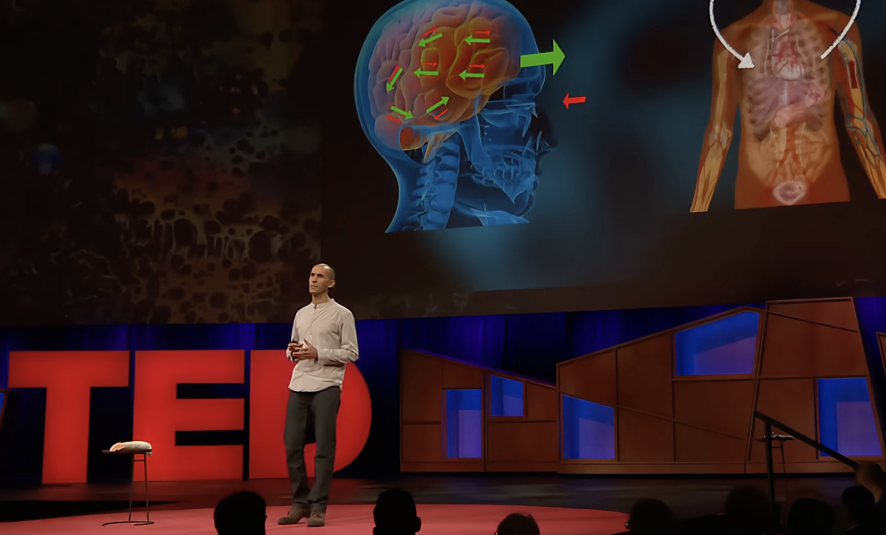
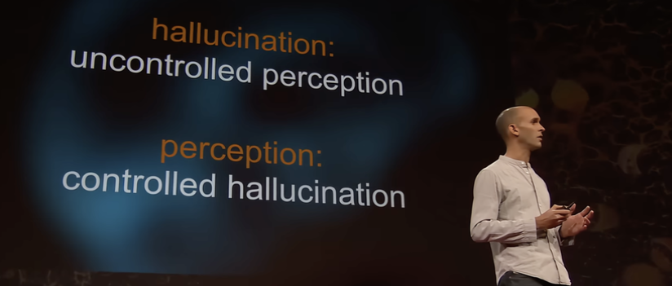
“The brain is like a prediction engine. Our perception of the world is conjured through a process of informed guesswork, as the brain combines incoming sensory signals with its prior expectations or beliefs about the way the world is, to form an interpretation of reality.“
“We’re all hallucinating all the time. It’s just that when we agree about the hallucinations, we call them reality.”

Slide 36


Slide 37
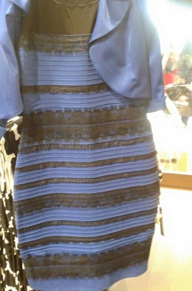
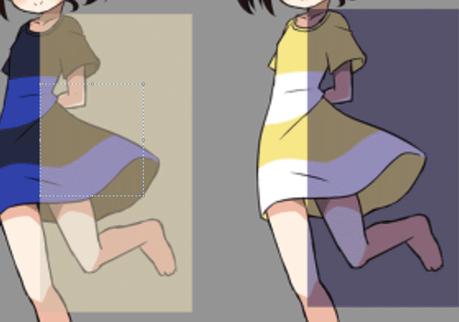
Notes:
What colours do you see when you look at this dress?
This phenomenon arises because of predictions our brain is making based on previous experience. Colours look very different depending on whether they are in direct light or in shadow. And so, when our brain receives signals from our eyes encoding information about the outside world, our brain sometimes needs to adjust what it thinks it is seeing based on how certain colours have previously appeared in either a light or a dark environment.

Slide 38
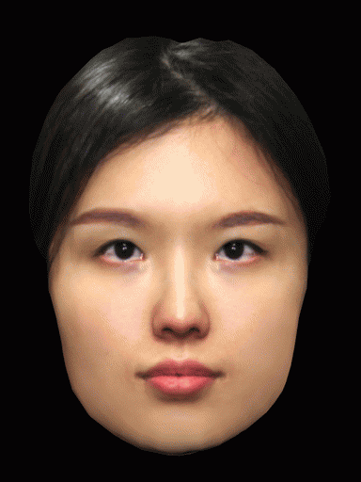
Notes:
The hollow mask illusion is another illustration of the impact expectations can have on our experience of reality. Even though we know that one side of this face is concave, rather than convex, our brains can’t help but ‘correct’ this visual input based on our previous experience of seeing faces.

Slide 39

Expectations (Priors)
Sensory input
(Posteriors)
Notes:
In FND, symptoms can occur when an individual’s perception of reality relies too heavily on expectation, at the expense of conflicting sensory inputs from the body.
For example, in a patient who develops tingling during a panic attack, they may fear they are having a stroke. Expectation that their arm will therefore be weak in addition to the tingling, can become a self-fulfilling prophecy as they find it difficult to integrate proprioceptive information from the arm that it is in fact still capable of normal movement.
In patients with acute onset functional weakness, it is common that after a brain scan and doctor’s explanation that the weakness is potentially fully reversible, they quickly recover normal function. Their expectations about their body change in response to the reassuring information, disproving their belief that they'e had a stroke.

Slide 40
Overview
What is FND?
Terminology
“Where is the lesion?”
  Traditional and modern approaches to neurological diagnosis
Functional neurological symptoms
  How are they diagnosed?
  How do they occur?
  Why do they occur?
  How can they be treated?

Slide 41
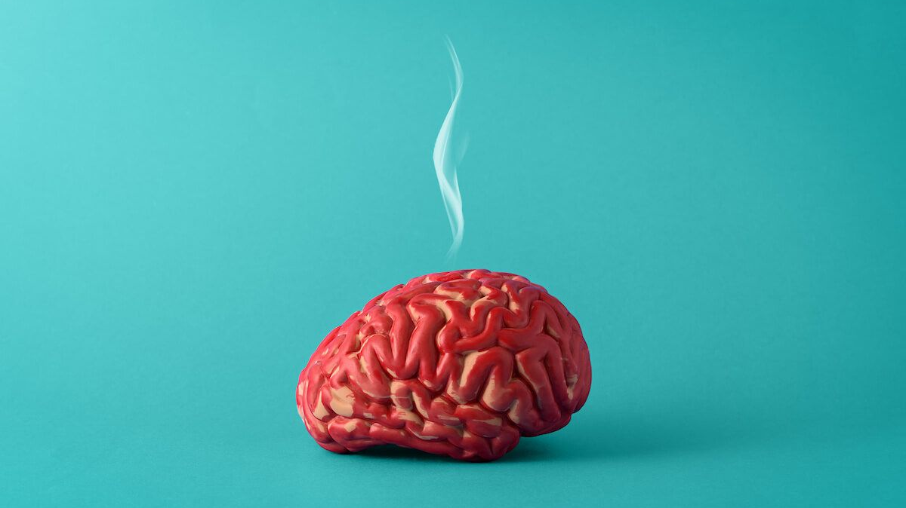

Slide 42
Precipitating
Physical injury
Illness
Migraine
Poor sleep
Precipitating
Relationship problems
Work problems
Death/divorce
Redundancy
SOCIAL
BIOLOGICAL
Predisposing
Predisposing
Trauma/neglect
Financial stresses
Lack of social support
Autistic Spectrum Disorder
Female gender
Sexism
Perpetuating
Family/work problems
Invalidating attitudes from HCP
Litigation
Perpetuating
Chronic pain
Chronic medical conditions
Autonomic arousal
Bereavement
Precipitating
Panic attack
Traumatic event
Predisposing
Health anxiety
Previous psychiatric diagnoses
Alexithymia
Perpetuating
Untreated anxiety, low mood or trauma
Traumatic interactions with healthcare professionals
Fixed illness beliefs
PSYCHOLOGICAL

Slide 43
Overview
What is FND?
Terminology
“Where is the lesion?”
  Traditional and modern approaches to neurological diagnosis
Functional neurological symptoms
  How are they diagnosed?
  How do they occur?
  Why do they occur?
  How can they be treated?

Slide 44
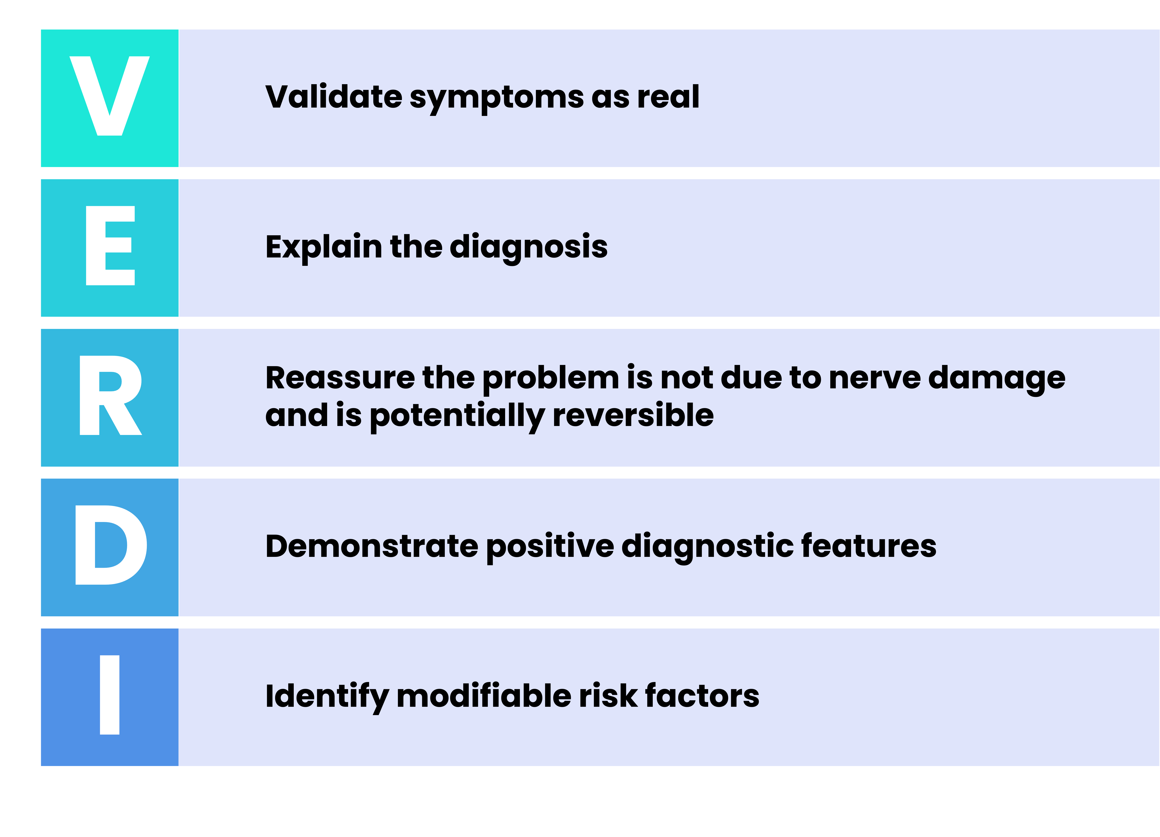

Slide 45
DON’T
Start with telling them what it’s not.
Tell the patient it’s ‘nothing serious’ or ‘nothing to worry about’
Tell the patient it’s definitely going to get better on its own

Slide 46
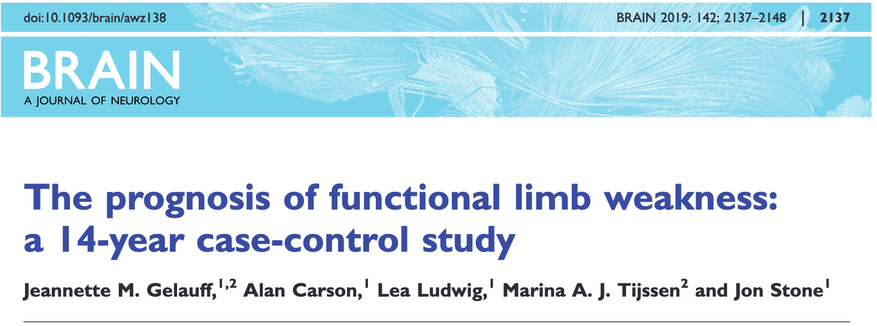
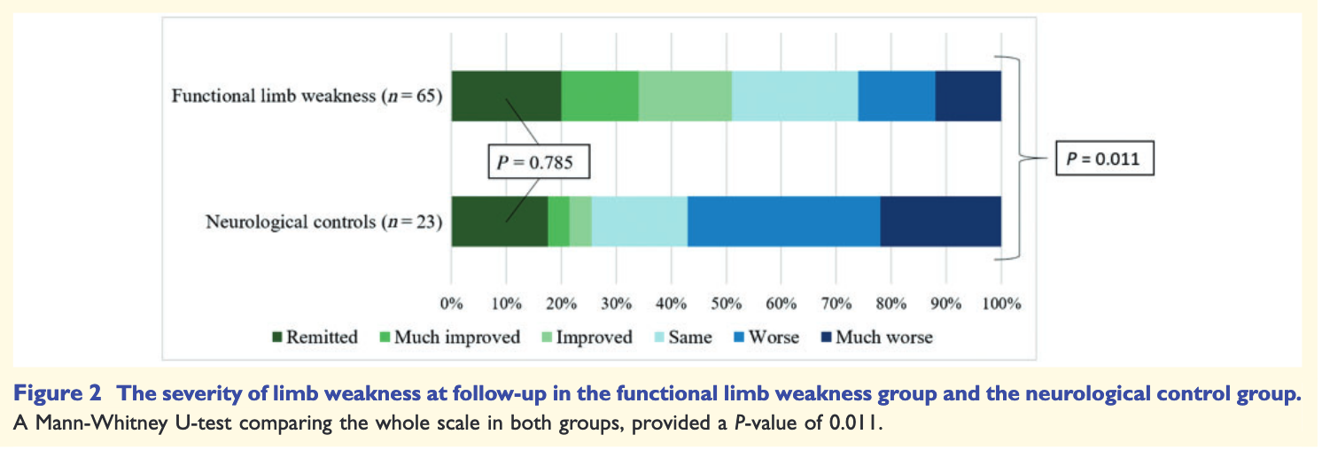

Slide 48
Treatment Triage
SOCIAL
Relationship problems
BIOLOGICAL
Migraine
Chronic pain
Bereavement
Autonomic arousal
Anxiety
Low mood
PTSD
PSYCHOLOGICAL

Slide 49
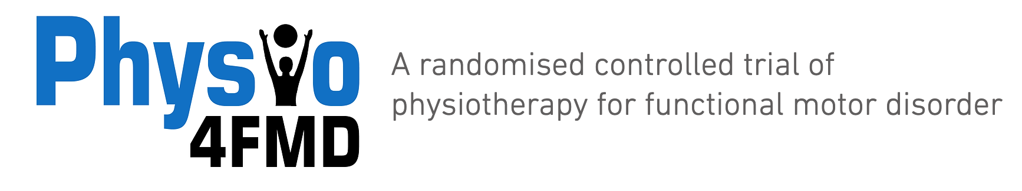
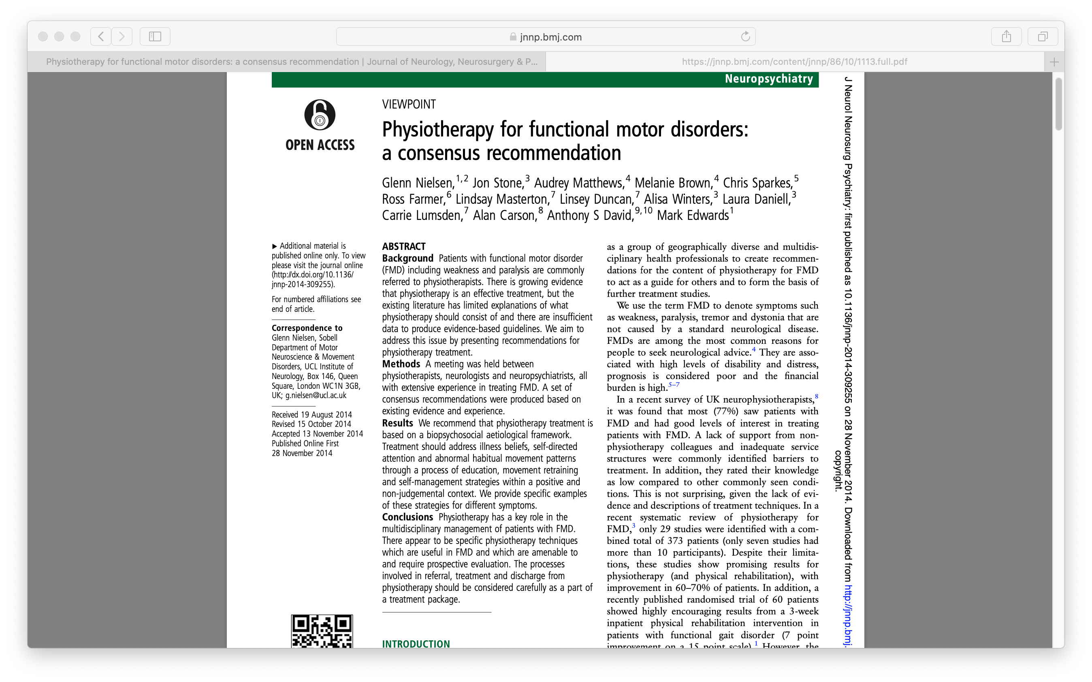
Management
Name and explain the diagnosis
Treat risk factors eg.
  Migraine
  Pain
  Depression/anxiety/PTSD if present
Lifestyle advice
  Avoid ‘Boom and Bust’ phenomenon with fatigue, pacing
Physiotherapy in patients with functional movement disorders

Slide 50


Slide 51
Take home messages
FND is a common, real way that patients can develop neurological symptoms
It is a brain network disorder, like a software problem/glitch on a computer
It is NOT the same as malingering, which is rare.
Some investigations may be needed, however it is a positive diagnosis rather than a diagnosis of exclusion
Often, the more patients focus on their symptoms, the worse they get
Demonstration/explanation of the positive diagnostic features can be helpful therapeutically
Not explaining the diagnosis, or simply saying ‘we’ve excluded a structural/serious problem’ can exacerbate the condition in the long run
It is often not ‘caused by’ stress.
Lots of patients with FND feel neither stressed nor anxious. However psychological symptoms and stressful life events can be precipitating and perpetuating factors
Treatment depends on the patient symptoms and risk factors

Slide 52

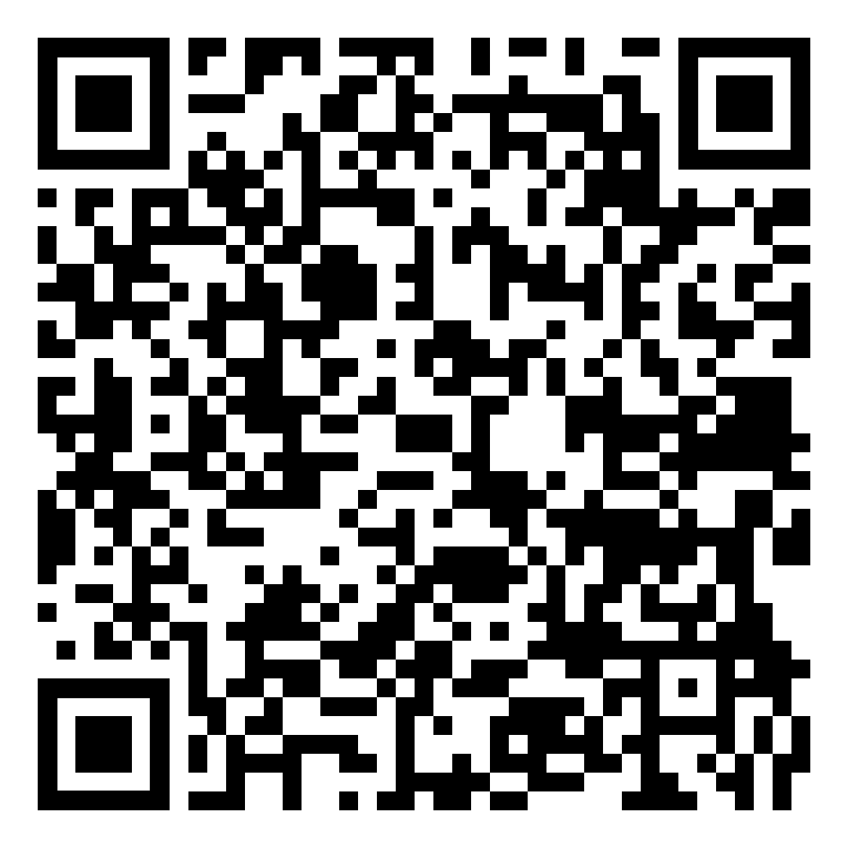


Slide 53
Acknowledgements
Prof Mark Edwards - neurologist at the IoPPN
Dr Biba Stanton - neurologist at King’s College Hospital
Dr Jan Coebergh - neurologist at St. George’s hospital
Dr Glenn Nielsen - neurophysiotherapist at St. George’s hospital
Dr Marianne Novak - neurologist at St. George’s hospital
Dr Tiago Teodoro - neurologist at St. George’s hospital

