Slide 1
Enduring symptoms – indicators of disease and /or entities in their own right: a challenge for patients and professionals.
June 2026
Chris Burton

Slide 2
Conflict of interest
I am employed by the University of Sheffield as a university professor.
In the last 2 years I have received research grant funding from UK National Institute for Health and Care Research (EIFFEL, RESHAPE-Care) and UK Research & Innovation (Complex Emotions Hub)
Publishing royalites for ABC of Medically Unexplained Symptoms (Wiley, 2012)
I am a GP, not a general physician as stated in the programme.

Slide 3
Conclusion
Enduring physical symptoms can be both indicators of disease AND things in their own right.
There is a science behind this that professionals need to recognise
Professionals need to find ways to “ride two horses” – looking for disease and managing symptoms at the same time
There is a need for collaborative public discussion that goes beyond binary mind-or-body dualism.

Slide 4
A “simple” example: acute and chronic pain
John broke his leg when he fell hillwalking.
8 months later he still has pain and sensitivity in the ankle, but his specialist assures him that the bones are fully healed and there is no remaining damage.
Jane broke her leg when she was pushed down some stairs by her violent partner. She had just been to her GP for treatment of depression (which she has had intermittently since her teens)
8 months later she still has pain and sensitivity in the ankle, but her specialist assures her that the bones are fully healed and there is no remaining damage.

Slide 5
Acute and chronic pain
Acute pain can morph into chronic pain while the original injury is healing
This happens because the brain’s pain processing system is thrown out of balance and may become stuck in an “on” state.
Psychological and social factors can make this more (or less) likely
But they are neither sufficient nor necessary

Slide 6
Some more challenging examples
Anne gets dizzy. When it started her GP said it was a viral ear infection, but now he says that has gone. She recently had a normal MRI and the neurologist said she had “tripleP-D” then asked her if she was stressed.
Bill had colitis a few years ago and his specialist assures him it is in remission, however he still has to go to the bathroom 2 or 3 times most mornings and worries about eating in restaurants.
Claire has widespread pain and difficulty sleeping. Her friend told her she had fibromyalgia but that the meds would make her feel terrible.
….
Zoe has multiple physical symptoms but gets frustrated that tests are always negative. Her physician suspects there is trauma in her background but can’t seem to get a handle on it.

Slide 7
Trajectories of symptoms, diagnosis and treatment
1. 2. 3. 4. 5.
Symptoms
Pathology
A: Conventional trajectory
Pre-symptomatic
Symptomatic / diagnostic
Treatment
Recovery
Resolution
B: Enduring symptoms
Symptoms “detached” from pathology
Symptoms
Pathology
C: “Unexplained” symptoms
Unrecognised / missed pathology
“Different” pathology (e.g. mental)
Other
Symptoms
Pathology

Slide 8
Two forms of Persistent Physical Symptoms, with moral implications
Moral status as
casualty of illness
Symptoms
Pathology
Moral status as
not having real illness
Symptoms
Pathology

Slide 9
Persistent physical symptoms
Symptoms ….
Pain
Fatigue
Dizziness
Breathlessness
…
that are…
Secondary - to a disease or injury which has resolved / remitted
Primary – there was no clearly defined initial illness
Such as …
Chronic pain / Fibromyalgia
GI disorder such as IBS
Post infection disorders
Fatigue in Long Term Conditions (e.g. MS, RA)
(Löwe, Lancet 2024)
With a difficult history of conceptualisation (and names) ….
Somatisation
“Medically Unexplained Symptoms”
Functional disorders

Slide 10
Overview
Enduring physical symptoms can be both indicators of disease AND things in their own right.
There is a science behind this that professionals need to recognise
Professionals need to find ways to “ride two horses” – looking for disease and managing symptoms at the same time
There is a need for collaborative public discussion that goes beyond binary mind-or-body dualism.

Slide 11
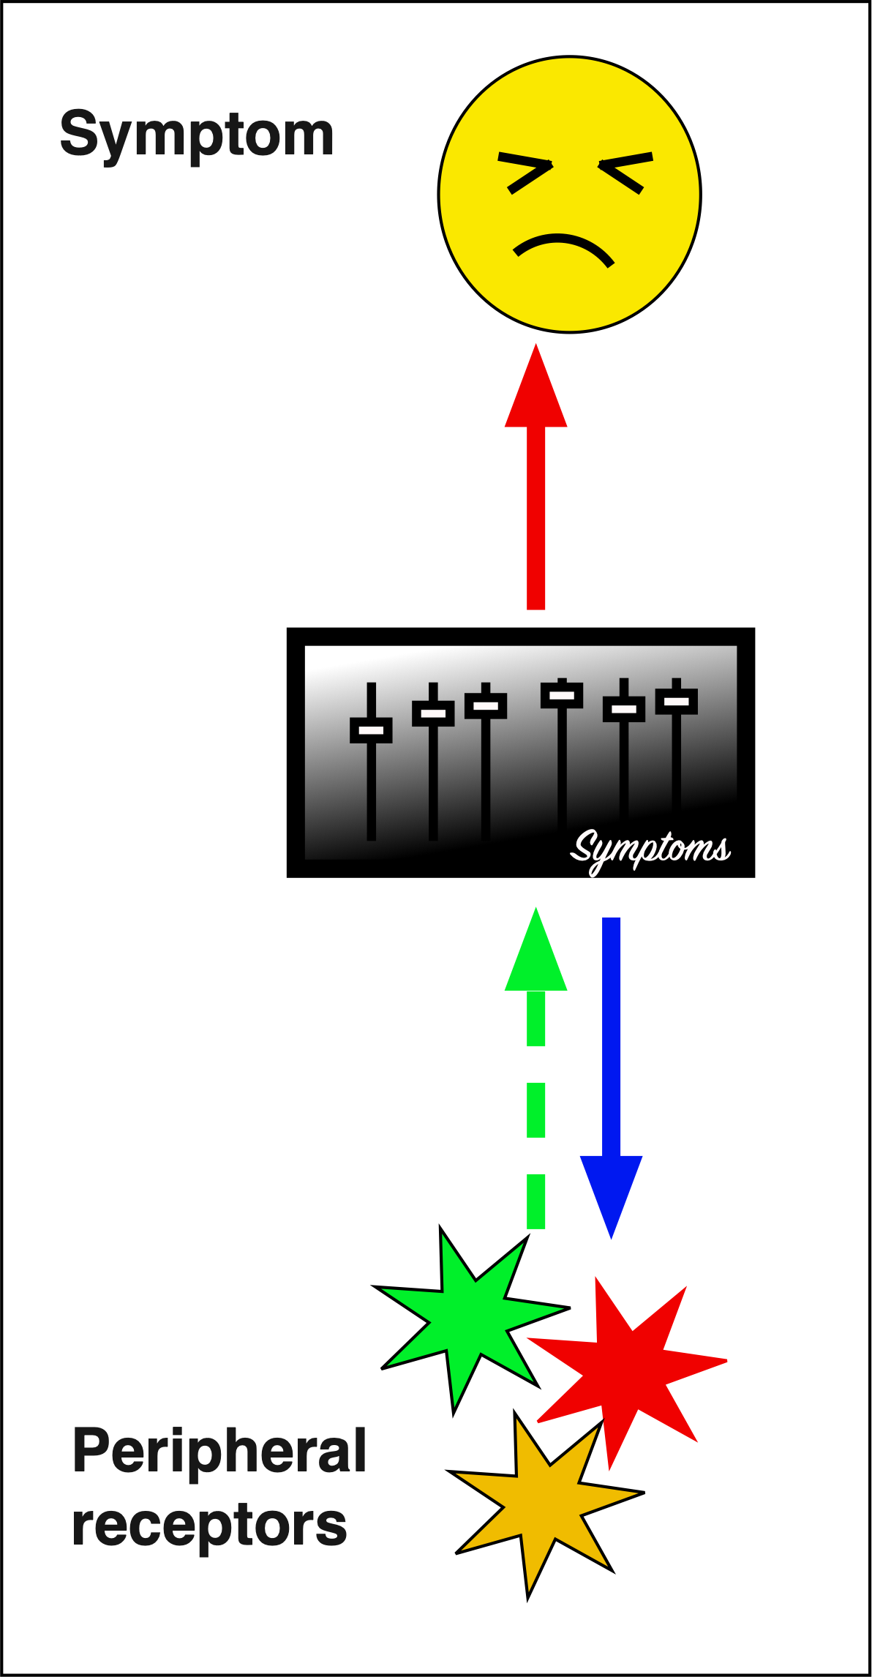
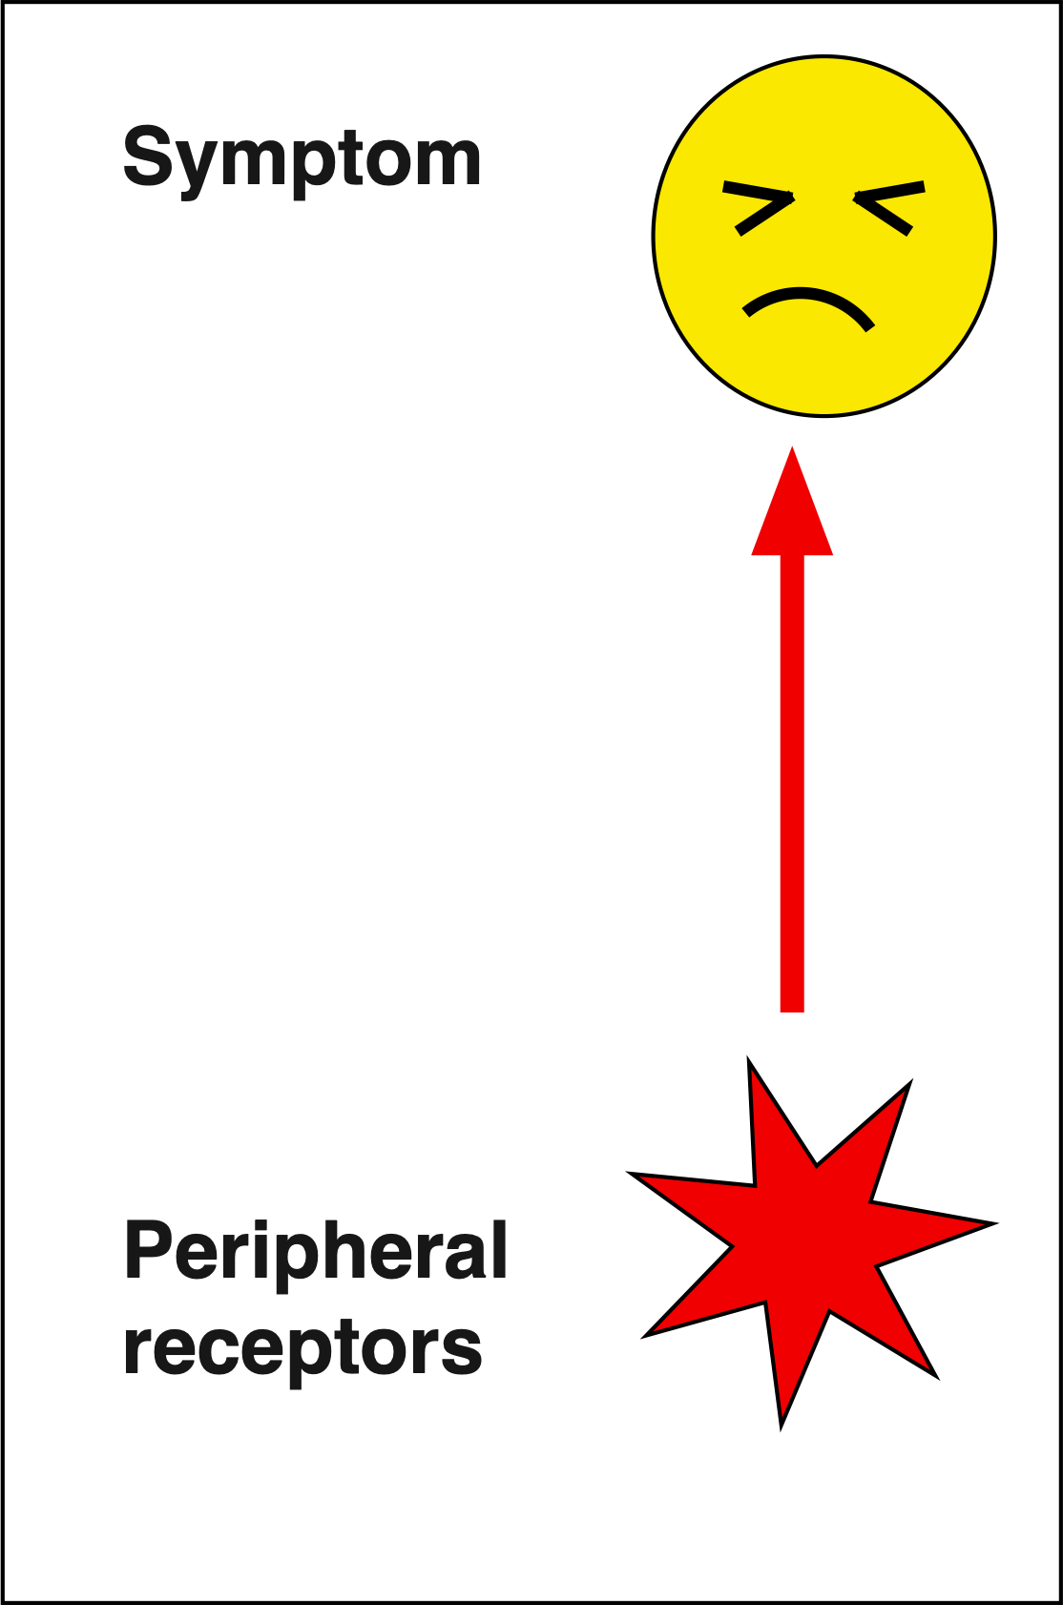


What is a symptom?
A physical sensation indicating actual or threatened disease
When persistent may become an entity rather than a signifier

Slide 12
Persistent Physical Symptoms are associated with things in the body
Low grade inflammation
Autonomic nervous system “imbalance”
Changes in microbiome
Genetic and epigenetic differences
Autoantibodies
Altered interoception

Slide 13
Persistent Physical Symptoms are associated with brain-body signalling
Low grade inflammation
Autonomic nervous system “imbalance”
Changes in microbiome
BRAIN
BODY
Genetic and epigenetic differences
Autoantibodies
Altered interoception

Slide 14
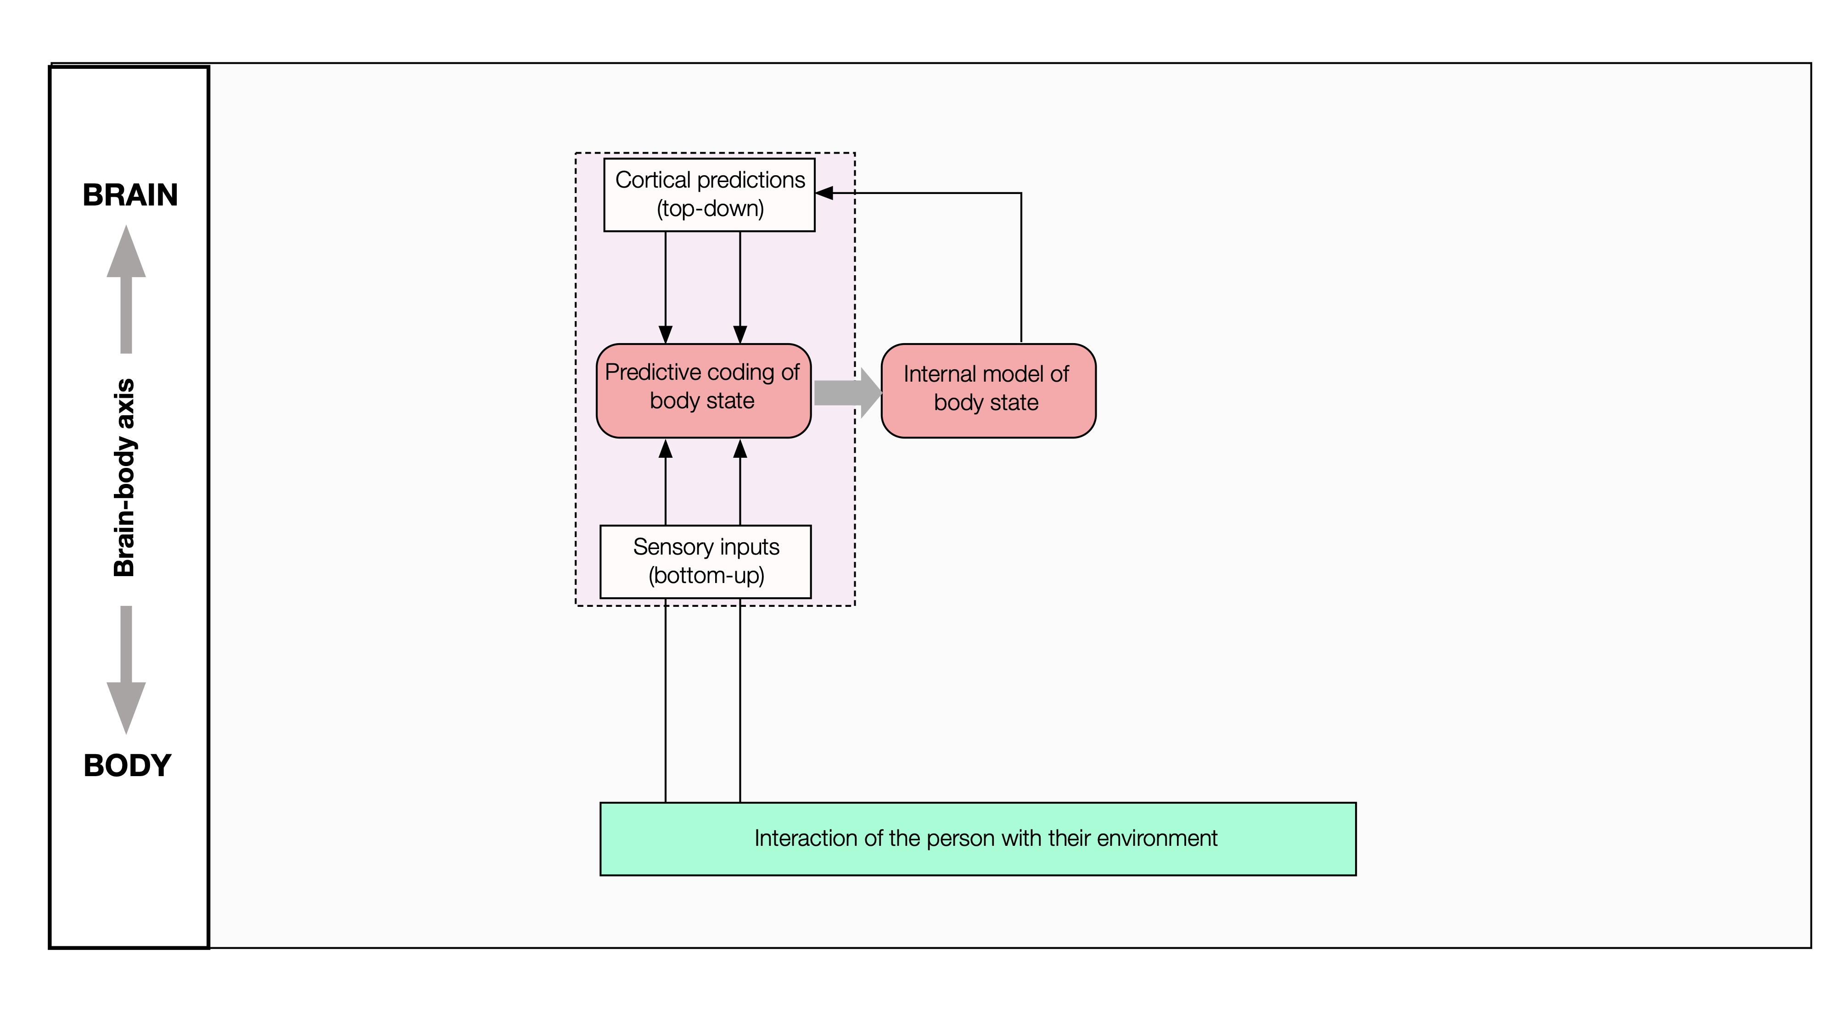
Interoception control loop

Slide 15
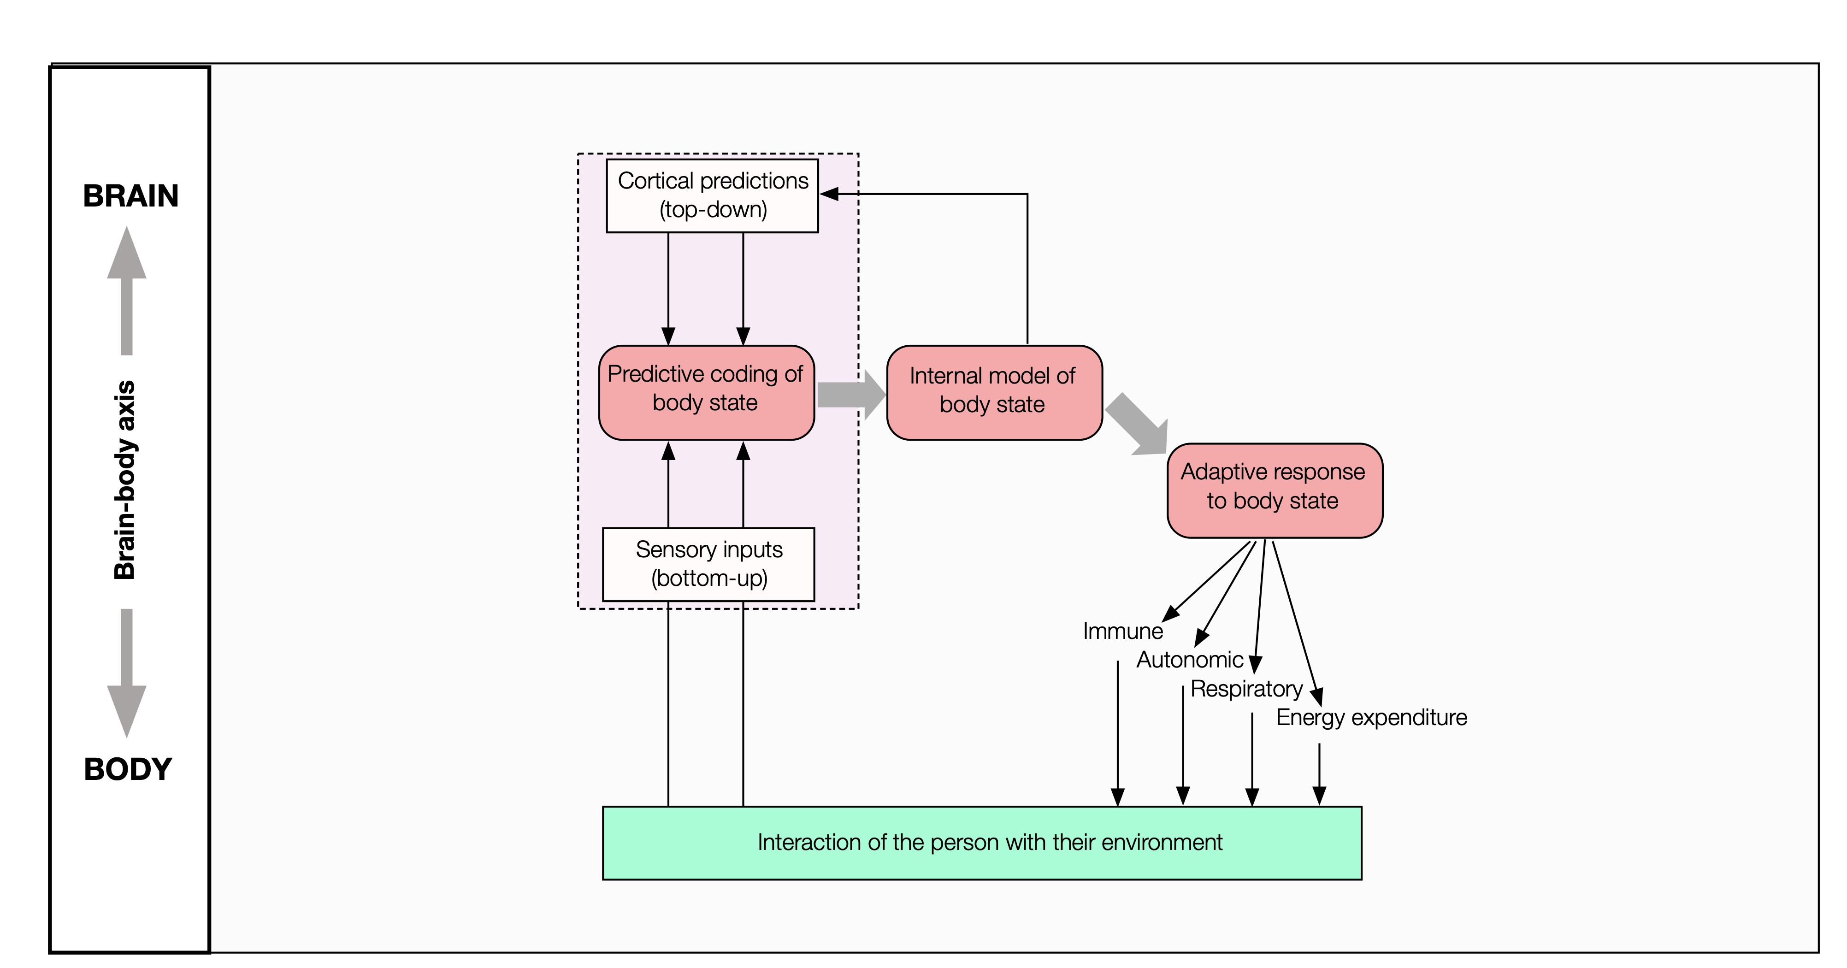
Interoception- allostasis control loop

Slide 16
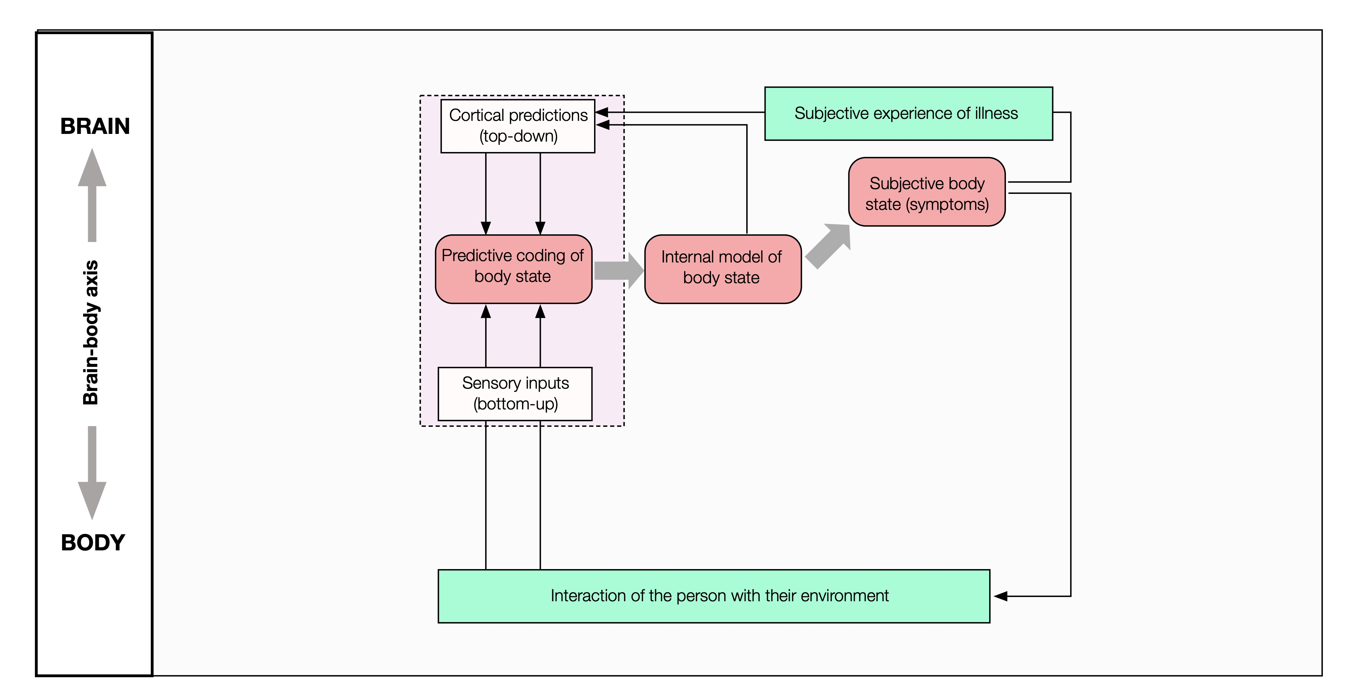
Interoception – perception loop

Slide 17
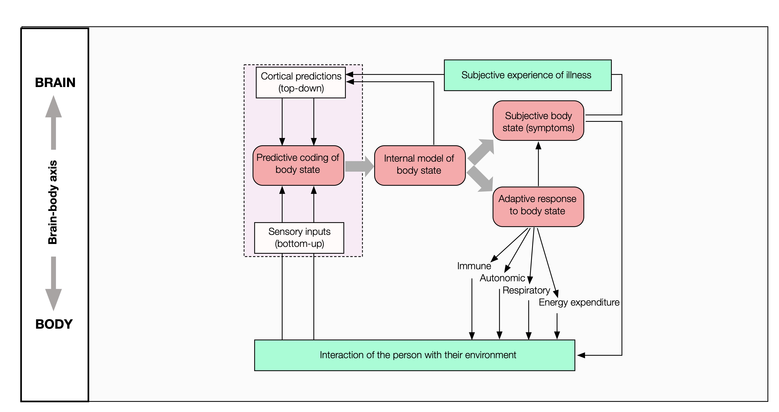
Dual loops

Slide 18
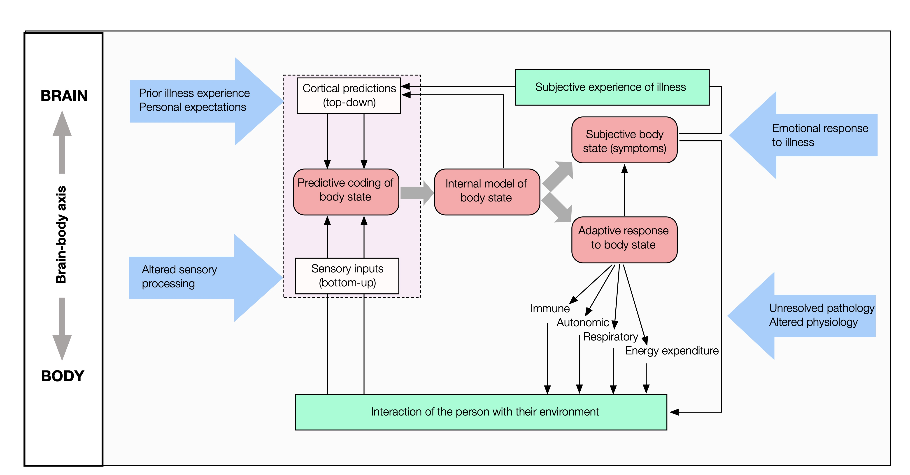
External things come into play too

Slide 19
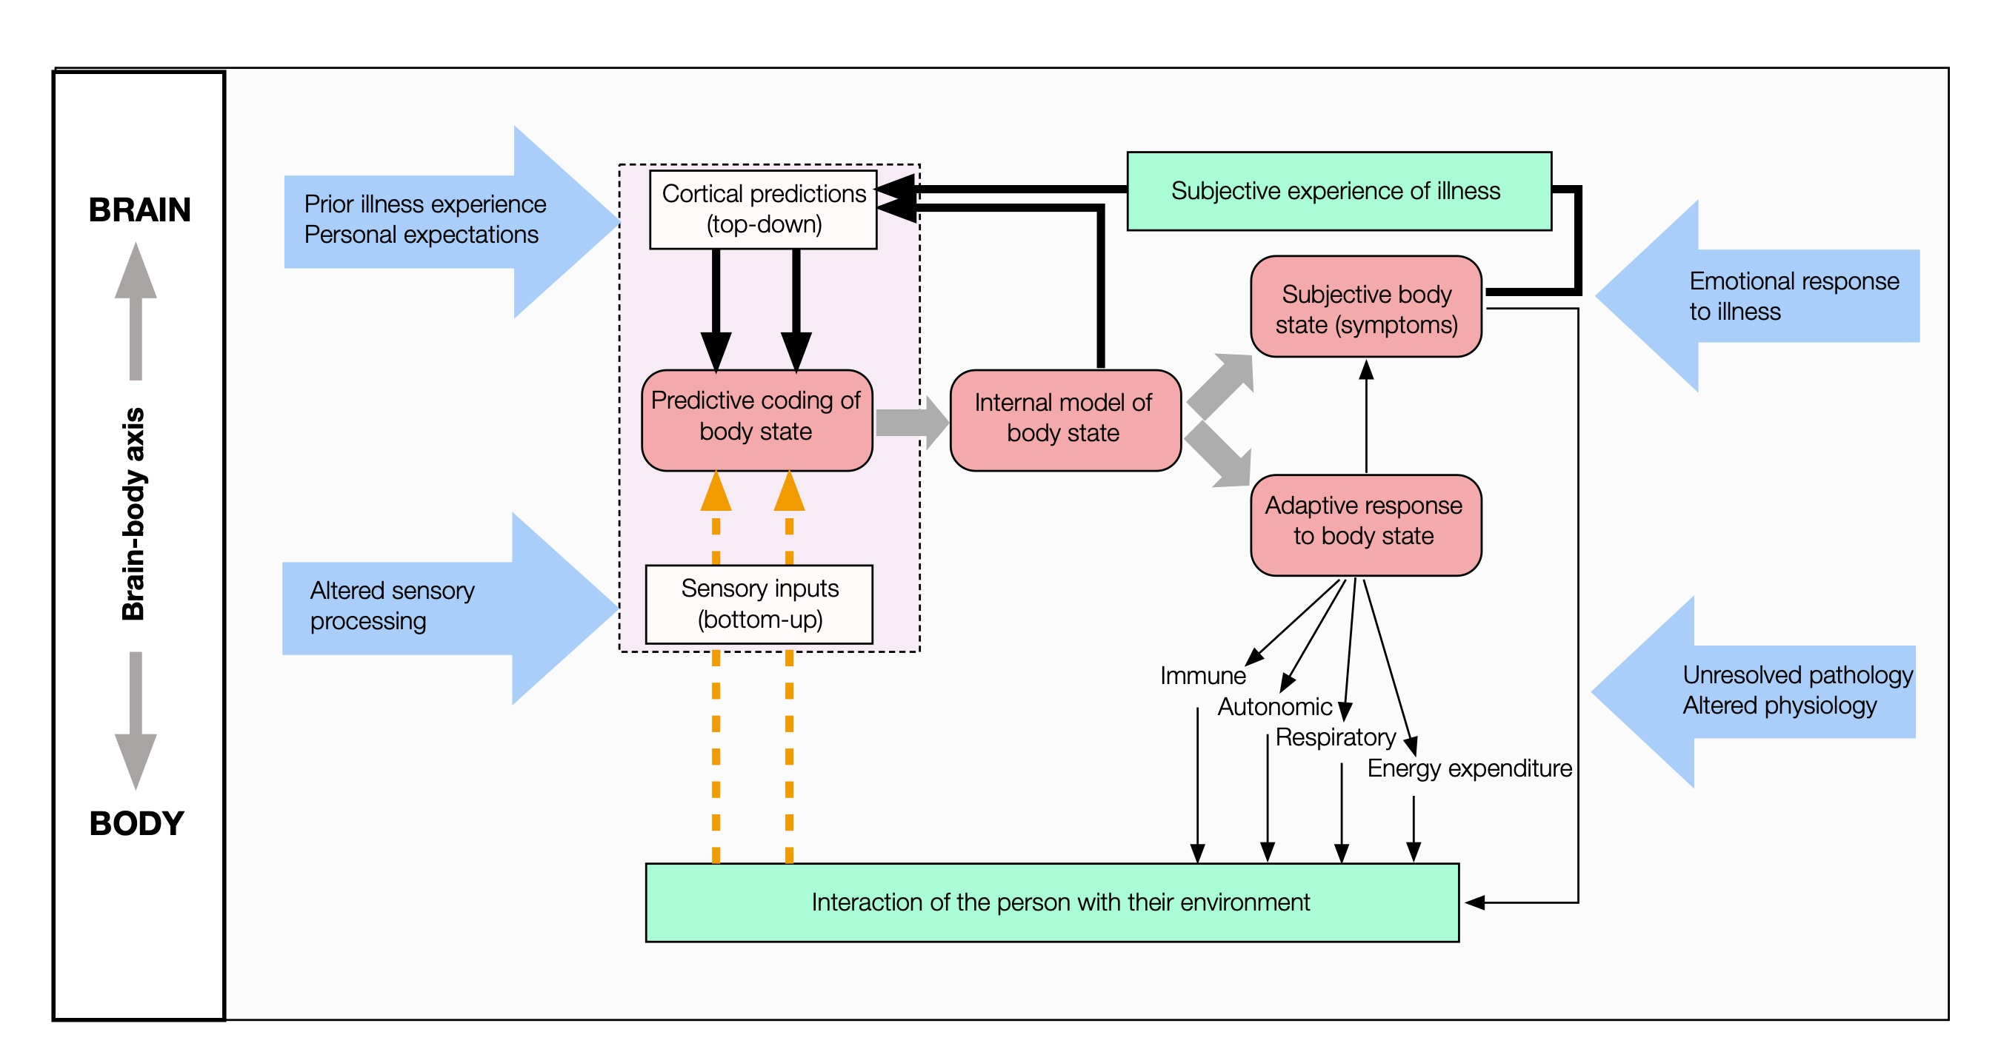
When the system breaks
Dominance of cortical “predictions”
Persistent physical symptoms
Always-on allostatic signalling
Distortion / loss of interoceptive signals
x

Slide 20

Further reading on this

Slide 21
Overview
Enduring physical symptoms can be both indicators of disease AND things in their own right.
There is a science behind this that professionals need to recognise
Professionals need to find ways to “ride two horses” – looking for disease and managing symptoms at the same time
There is a need for collaborative public discussion that goes beyond binary mind-or-body dualism.

Slide 22
When symptoms are present, but all tests are negative?
Why is it wrong to exclude the body?
Because we will continue to find new things that will explain (part of) what’s going on
Because having risk factors for symptom disorders doesn’t stop you getting cancer
Because sometimes serious illnesses begin in innocuous or atypical ways
Why is it wrong to exclude the brain/ mind?
Increasingly clear that persistent symptoms (like ”chronic pain”) are disorders in their own right
Psychological processes are one of many mechanisms the brain deploys to protect / conserve resources. We are all different: some people are naturally more careful / threat-aware than others
Positive criteria reduce the risk of (mis-)attribution by default

Slide 23
Assessing persistent symptoms / low likelihood of pathology
Negative | Positive | Be very careful | Diagnostic
No red flag symptoms
Normal exam
Negative tests

Slide 24
Assessing persistent symptoms / low likelihood of pathology
Negative | Positive | Be very careful | Diagnostic
No red flag symptoms | Typical symptoms (e.g. IBS criteria)
Normal exam | “functional” signs on exam
Negative tests | Not a diagnosis of exclusion

Slide 25
Assessing persistent symptoms / low likelihood of pathology
Negative | Positive | Be very careful | Diagnostic
No red flag symptoms | Typical symptoms (e.g. IBS criteria) | Marked distress
Normal exam | “functional” signs on exam | Psychological history
Negative tests | Not a diagnosis of exclusion | History of abuse

Slide 26
Assessing persistent symptoms / low likelihood of pathology
Negative | Positive | Be very careful | Diagnostic
No red flag symptoms | Typical symptoms (e.g. IBS criteria) | Marked distress | Look up the syndrome criteria …
Normal exam | “functional” signs on exam | Psychological history | …. and make a differential
Negative tests | Not a diagnosis of exclusion | History of abuse

Slide 27
Framing expectation for things we won’t be able to see (aka negative tests!)
I’m doing these tests …
… to find out what is wrong with you
So if they’re negative will you do more?
… to confirm that there’s nothing serious going on
So you mean I have nothing going on?
…because most symptoms like this come from processes we can’t see, but I need to rule a few things out first
OK, so can you tell me about these?

Slide 28

Putting this to use …
Explanation for enduring symptoms based on brain-body signalling is scientifically plausible (and doesn’t mean “all in the mind”)
And it can be highly acceptable when delivered well. e.g. within an extended clinical consultation model
  Recognition
  Explanation
  Action
  Learning
And it can be effective.
(Burton, Mooney et al Lancet 2024)

Slide 29


Riding two horses

Slide 30
Overview
Enduring physical symptoms can be both indicators of disease AND things in their own right.
There is a science behind this that professionals need to recognise
Professionals need to find ways to “ride two horses” – looking for disease and managing symptoms at the same time
There is a need for collaborative public discussion that goes beyond binary mind-or-body dualism.

Slide 31
The big challenge – some messages
Psychological factors do not equate to psychological cause. This is not gaslighting
Fundamental psychological factor is not weakness or damage but a disposition towards a “better safe than sorry” mindset¹
Neuroscience gives us “hard” computational model in the brain that is not in the accessible bits of conscious mind.
Signalling between the brain and the body is in both directions. Evidence of a signal does not equate to evidence of cause.
Behavioural approaches (e.g. CBT-informed) have benefits for persistent symptoms regardless of original cause²
1. Van den Bergh, Perspect Psychol Sci 2020
2. Burton, BMJ Medicine 2026

Slide 32
Some stories
Anne gets dizzy… Jointly looking up Persistent Postural Perceptual Dizziness on neurosymptoms.org leads to a discussion that validates Anne’s experience and gives her confidence to try new strategies.
Bill had colitis… Explanation about post-inflammatory IBS makes sense to Bill. He decides to try some controlled exposure to social situations and he and his GP agree criteria for review and reconsideration of recurrence.
Claire has widespread pain … She completes the ACR self-report checklist and reviews the findings with her GP. They agree that she meets the criteria for fibromyalgia and agree to think of it as a pain processing problem. She’s interested to find that tai chi can be an effective treatment .
….
Zoe has multiple physical symptoms … She is able to be seen at a new Symptoms Clinic service where a detailed history allows her to see her symptoms as difficulties in communication between her brain and body. She thinks this might be a result of past trauma and decides to embark on a programme of psychotherapy. Her GP agrees to see her with new symptoms.
6 months later she attends with a new breast lump, her new localised breast cancer is quickly diagnosed and treated

Slide 33
Conclusion
Enduring physical symptoms can be both indicators of disease AND things in their own right.
There is a science behind this that professionals need to recognise
Professionals need to find ways to “ride two horses” – looking for disease and managing symptoms at the same time
There is a need for collaborative public discussion that goes beyond binary mind-or-body dualism.

